Slide 1
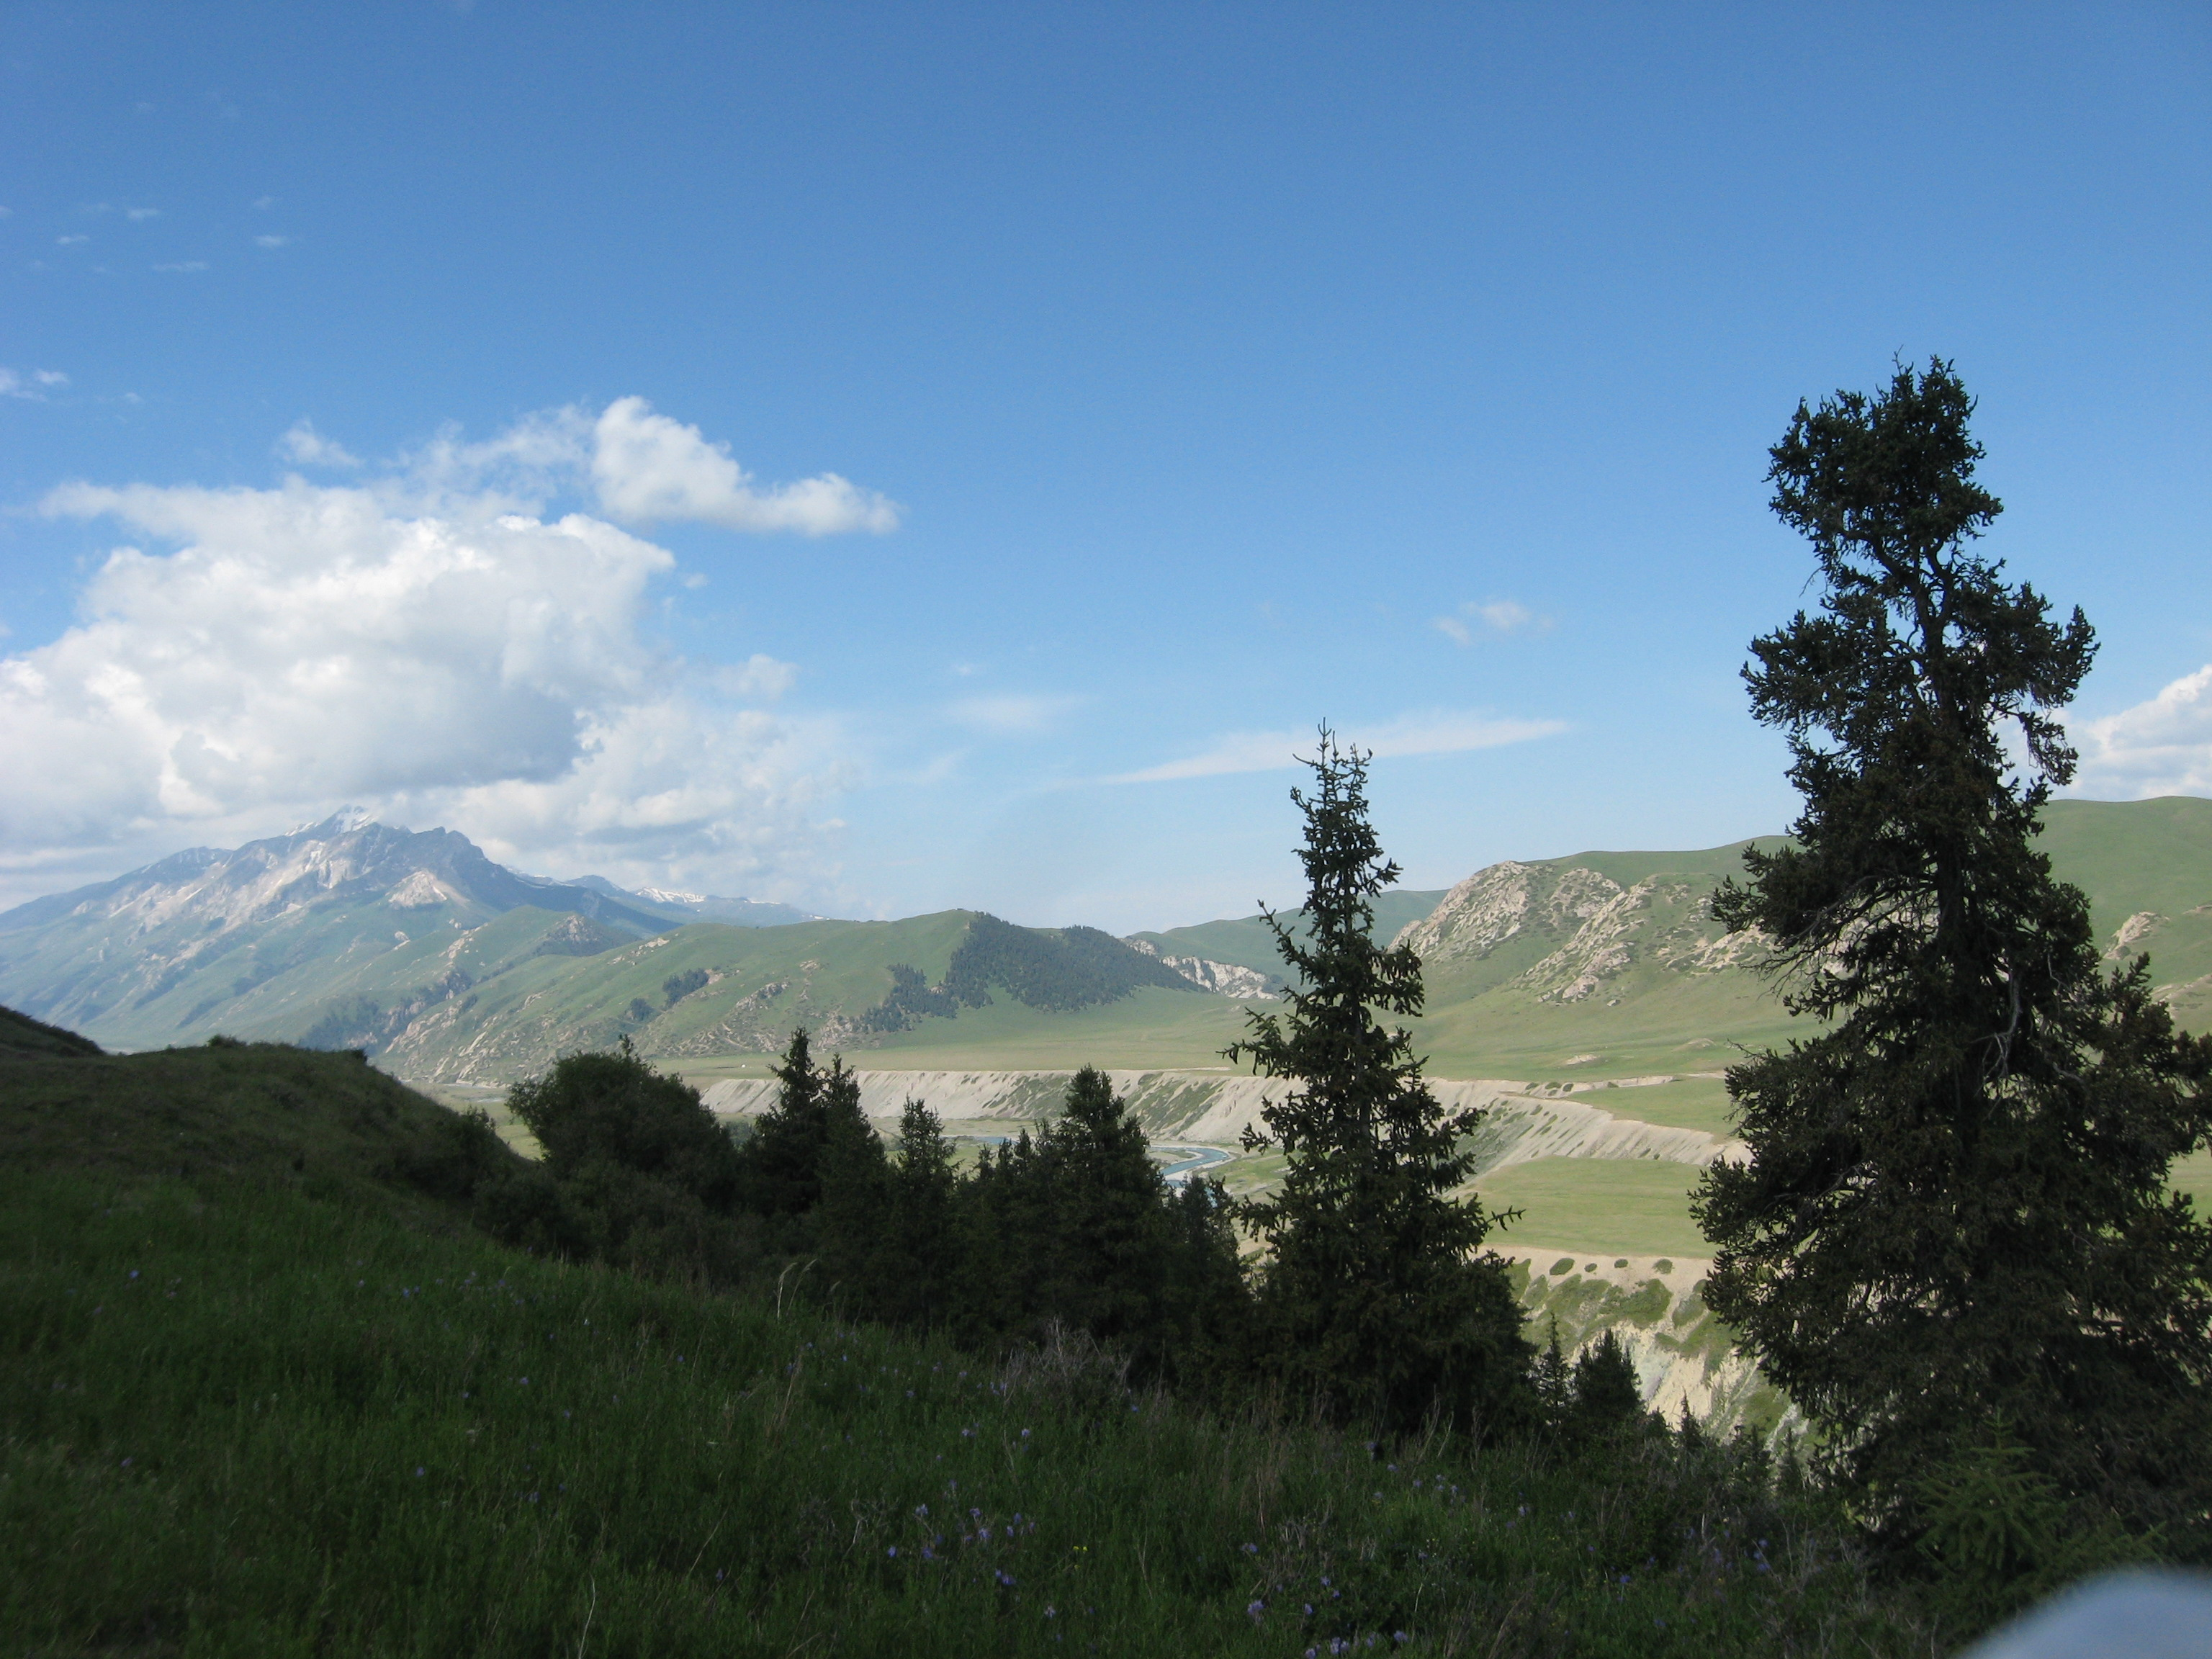
Georgiy Biske (St.Petersburg State University), Dmitriy Konopelko (St.Petersburg State University), Reimar Seltmann (NHM, CERCAMS)
Tectonic evolution of the Tien Shan revisited

Slide 2
General sketch of Paleozoic Tian-Shan (Alexeiev et al., 2015)

Slide 3
Main investigation problems and new achievements: 1. Precambrian basement 2. Arc and intraplate magmatism before the collision 3. Thrust collisional tectonics of the Eastern TS (not a problem with Central and Western TS) 4. Syn- to postcollisional magmatism

Slide 4
Precambrian basement
Northern Tian-Shan: granites and metamorphism of 1100-1045Ma (Kröner et al., 2013). Collisional Cambrian-Ordovician (500-460 Ma) metamorphism (Klemd et al., 2012, 2014; Коnopelko, Klemd, 2016; Kröner et al., 2012) of the Neoproterozoic volcanic-sedimentary cover. No lower Precambrian protolith
Middle Tian-Shan: Grenvillian basement with inclusion of Lower Proterozoic granitic fragments (1800-2300 мл) (Kröner et al., 2017), active margin or back-arc magmatism of 820-700 Ma (Konopelko et al., 2014, 2017). Ordovician and Carboniferous, not a Proterozoic metamorphism of the Kassan-Terek dome (Alexeiev et al., 2016; Mühlberg et al., 2016)
Southern Tian-Shan: no Precambrian in the Atbashi metamorphic complex (Kröner et al., 2013; Rojas-Agramonte et al., 2016), but it existed as a basement of some MC (Biske, 1996 and data unpublished). 550-660Ma (not AR-PR1)metamorphic age of the Garm basement (Käßner et al., 2016), problems yet unsolved with S.Hissar basement

Slide 5
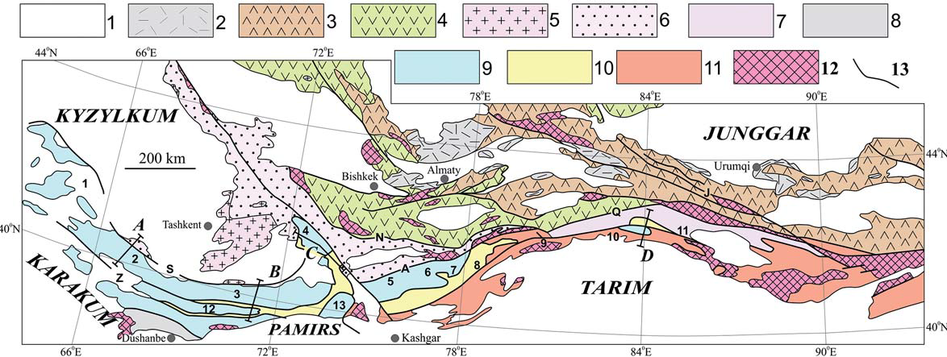
Main magmatic provinces of the Tian-Shan.
2 – Postcollisional volcanics of C2-P in the Northern TS
Accreted arcs of the Kazakhstan basement : 3 – Silurian – Lower Carboniferous, 4 –Lower Paleozoic,
5 –Continental active margin and magmatic arc of D-С2 (Kurama), 8 – the same of C1-2 (Hissar)
6 – Continental cover of Kazakhztan, 11 – the same of Tarim.
12 – Precambrian basement.

Slide 6
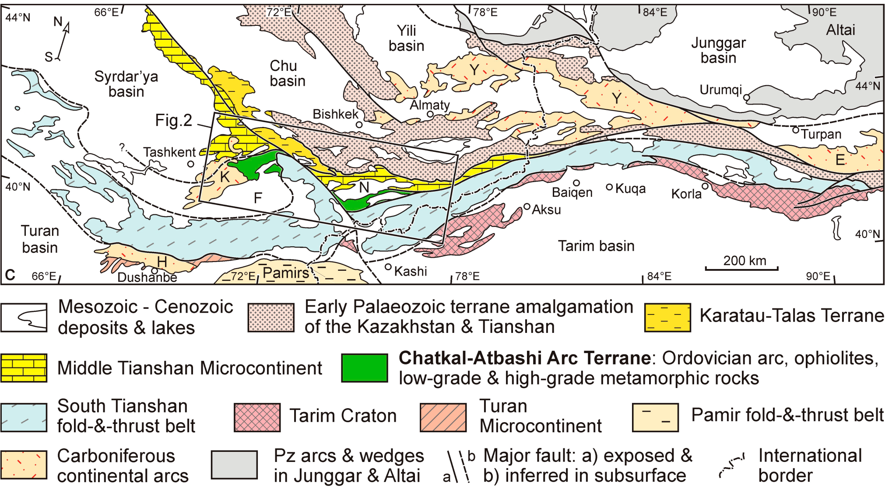
Ordovician island arc accreted to the Kazakhstan (Alexeyev et al., 2016). Bozbutau continental arc fragment of 467-445 Ma magmatic age and 1200-1700 Ma crustal model age

Slide 7
Beside of the active margin (425 Ma old Muzbulak granite of the Mogol-Tau, Konopelko et al., 2017) at least one island arc developed inside of the Turkestan (South Tian-Shan) ocean in Silurian

Slide 8
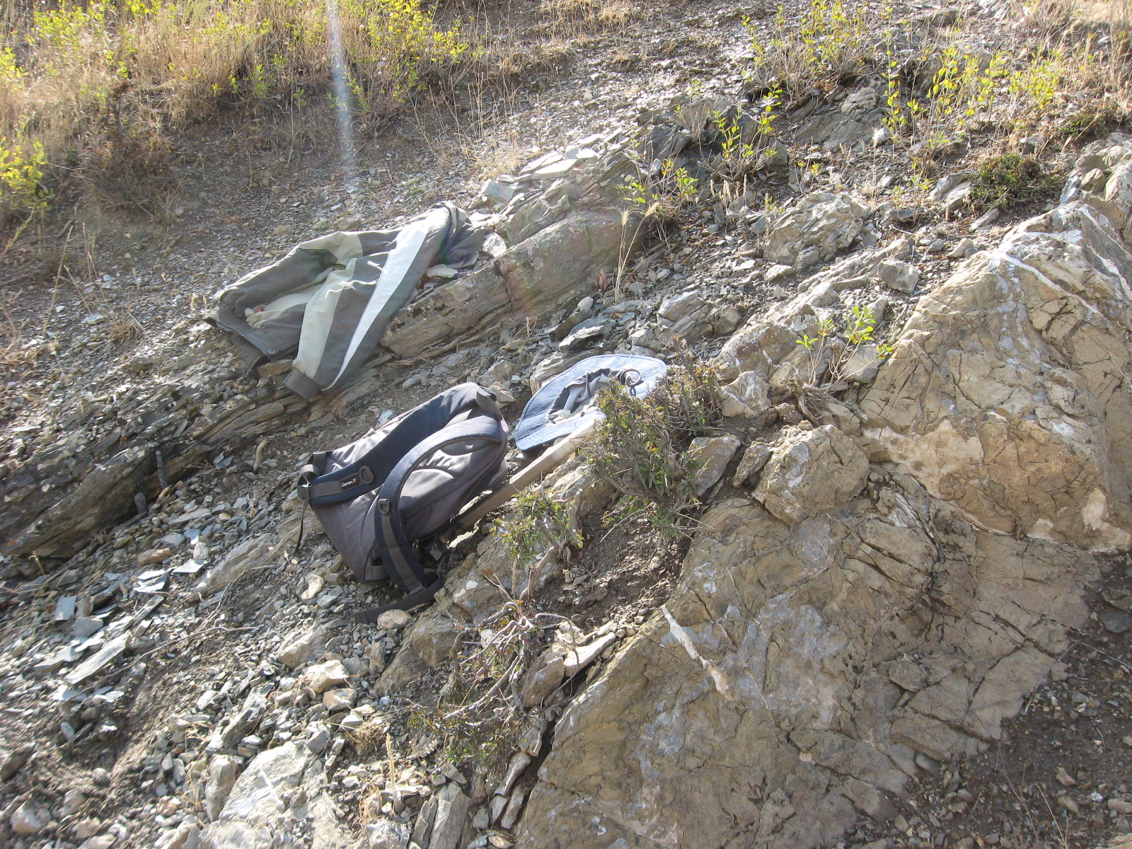
Lower Silurian Karatyube island arc of the Southern Ferghana: andesite breccia with graptolite slate interlayers. Silurian volcanic rocks were later relayed and accreted into the basement of Alai MC

Slide 9
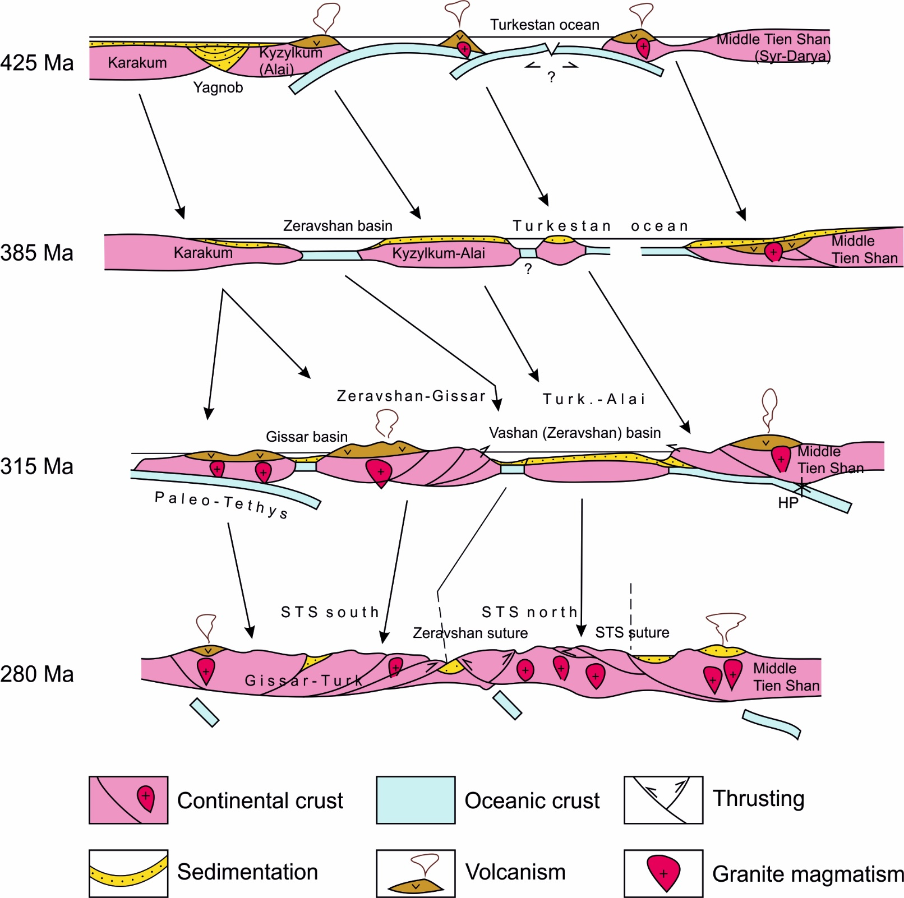
The western South.TS geodynamic cartoons

Slide 10
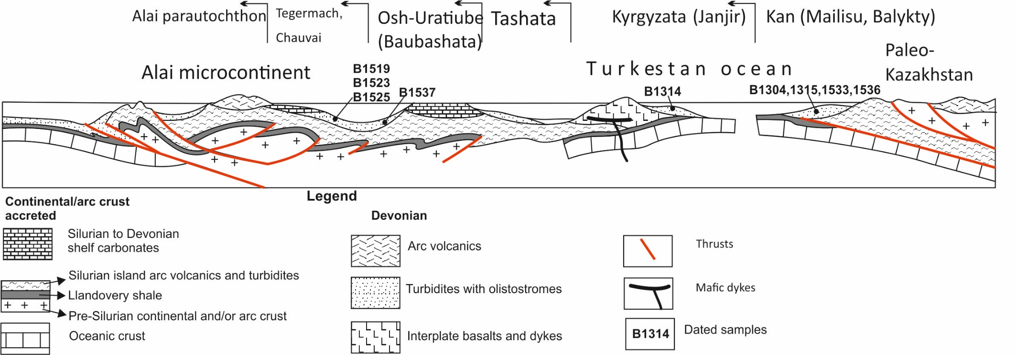
Devonian Alai microcontinent inside the Turkestan ocean consists mainly of accreted Silurian arc-origined and deep sea volcano-sedimentary material

Slide 11
Lower Silurian continental volcanic arc of Haidu, covered by Devonian carbonate platform. Haidu River, Great Yulduz depression, Chinese Southern Tian-Shan

Slide 12
Rhyodacites of 440 Ma, xenocrist. 2500 Ma (Alexeyev et al., 2015)

Slide 13
breccia
tuffs

Slide 14
Andesite breccia

Slide 15
Model of the OPS in respect to the Turkestan ocean (Safonova et al., 2016): seamount after IA volcanic \limestone debris

Slide 16
Haidu continental arc separated from the Tarim active margin in the Late Silurian – Early to Middle Devonian with spreading of the Kule marginal sea

Slide 17
General sketch of the Tian-Shan collisional geodynamics: Tarim to Junggar transect
Volcanism of the Bogdoshan arc completed before Moscovian when the arc covered by carbonates and then amalgamated with Kazakhstan-Yili continent
Last bathyal cherts of the STS are C2k-gh, last ocean uplift turbidites are P1as
No signes of the Triassic collision

Slide 18
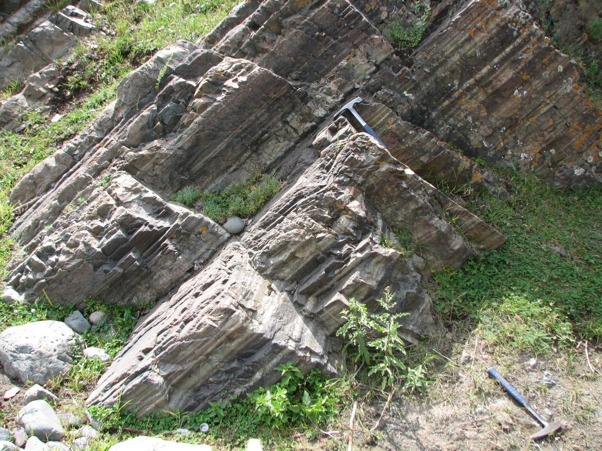
Lower Carboniferous tuffs of the Bogdoshan arc, Chinese North Tian-Shan, Dadungou River

Slide 19
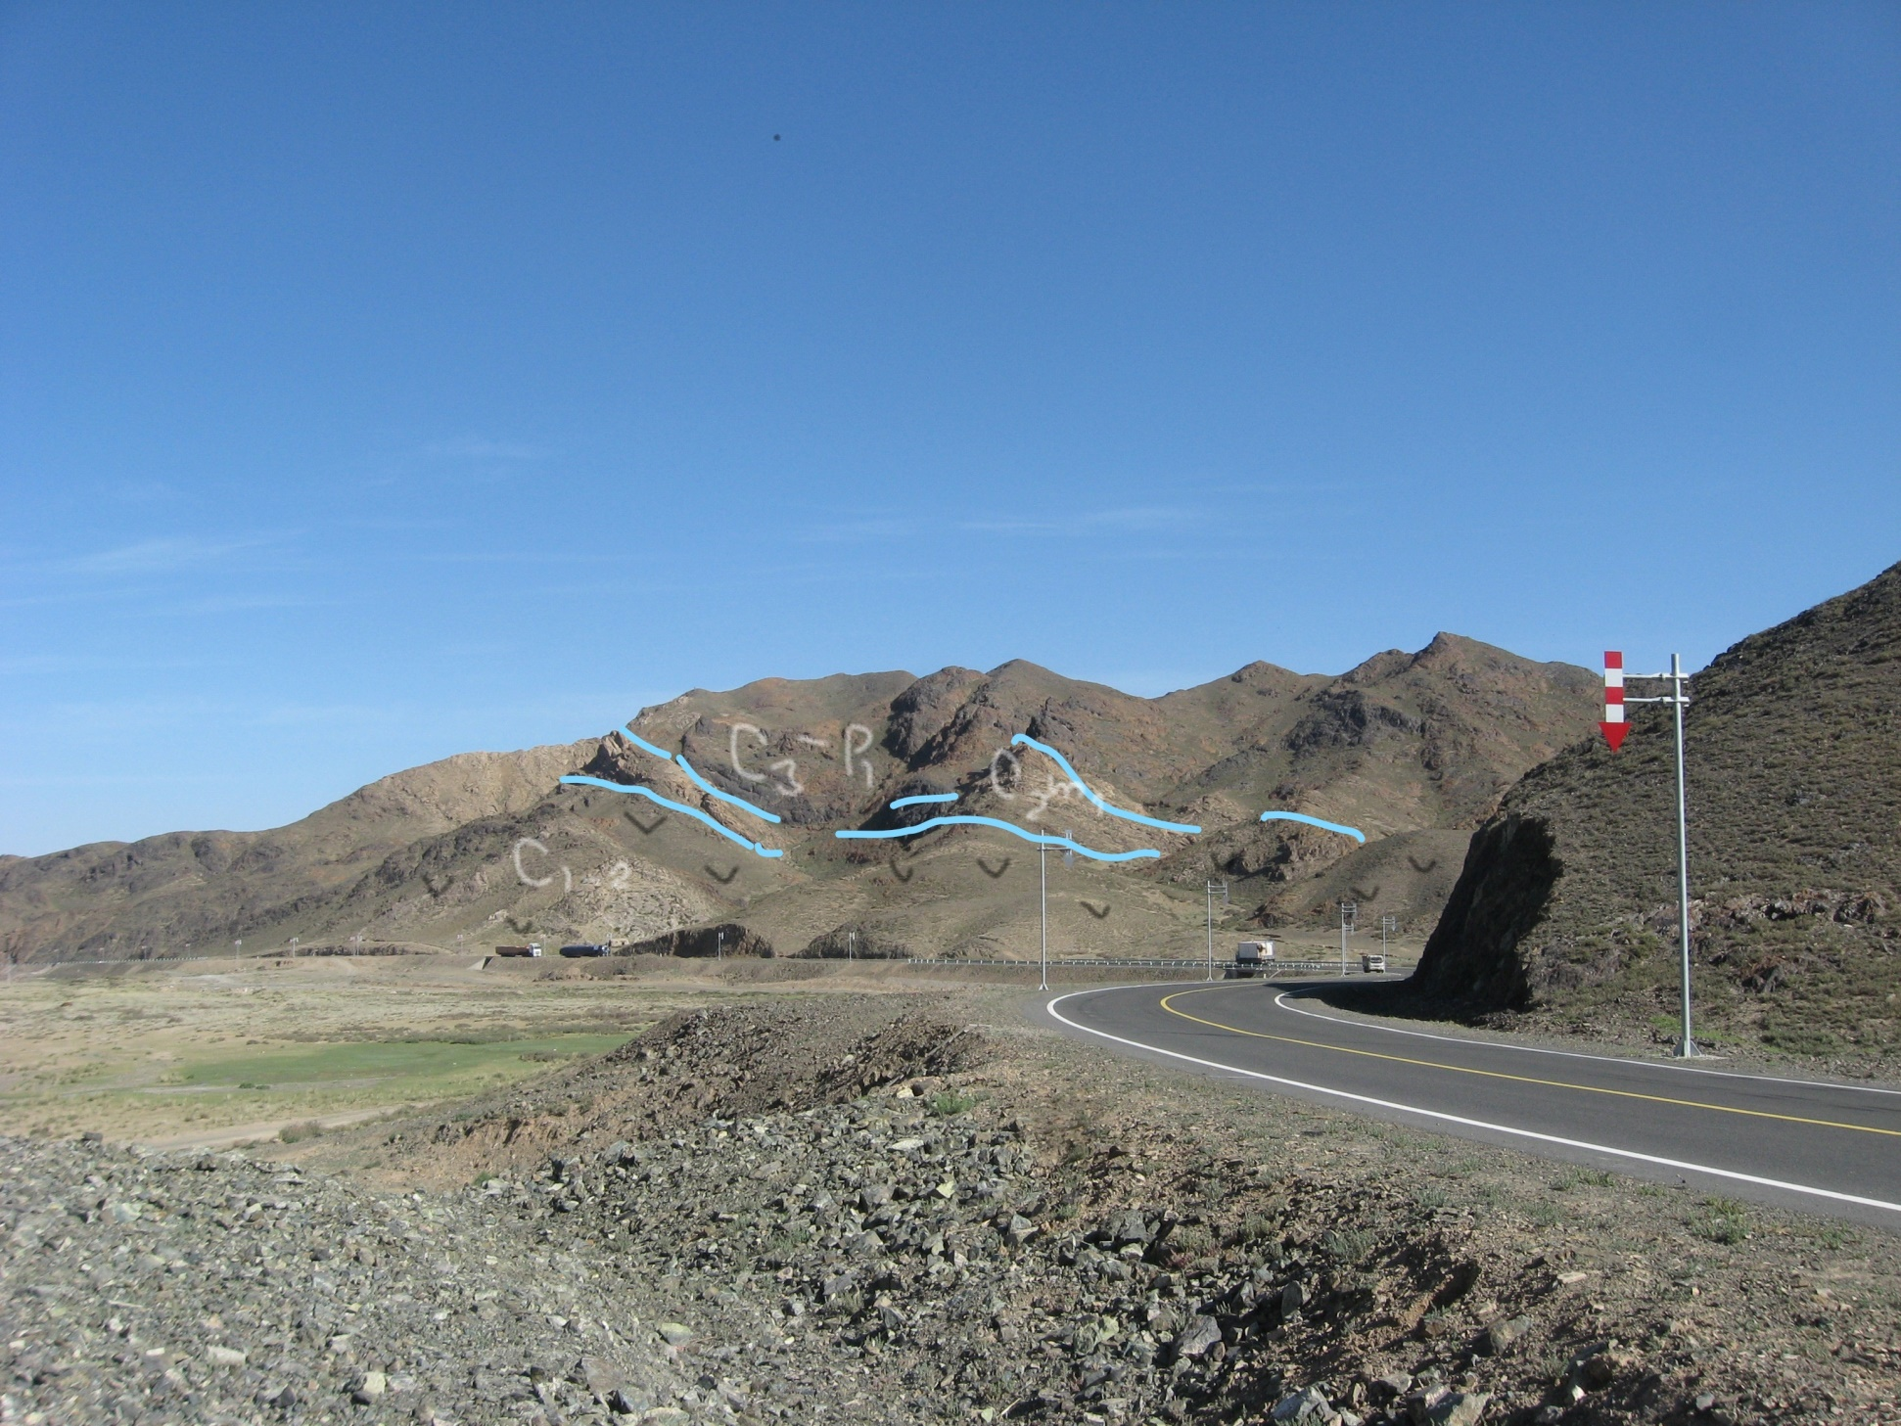
The end of arc volcanism in the eastern Bogdoshan Range, Northern Tian-Shan.
C1-2 – volcanic rocks, C2m1 – limestones, C3-P1 - shallow sea sandstones

Slide 20
The northern, Bukantau–Kokshaal branch of the collisional Southern TS has southward-directed thrusts originated after the Turkestan ocean crust subducted to the north under the Kazakhstan continent.
This branch is more than 2000 km long and includes mountains in the Kyzylkum, Nuratau, and Turkestan–Alai systems south of the Ferghana depression and Ferghana range. It also encompasses the Atbashi, Janyjer, Borkoldoi and Kokshaal mountains of
Kyrgyz Tian-Shan to the east, and the highest peaks of Han-Tengri, Pobeda, Halyktau (Harke) and other ridges of the Chinese Tian-Shan up to 90°E longitude.

Slide 21
Geological section across Chinese Southern Tian-Shan.
C2k-g – turbidites of the foredeep, with arc volcanic\carbonate S2-C2 nappes thrusted

Slide 22
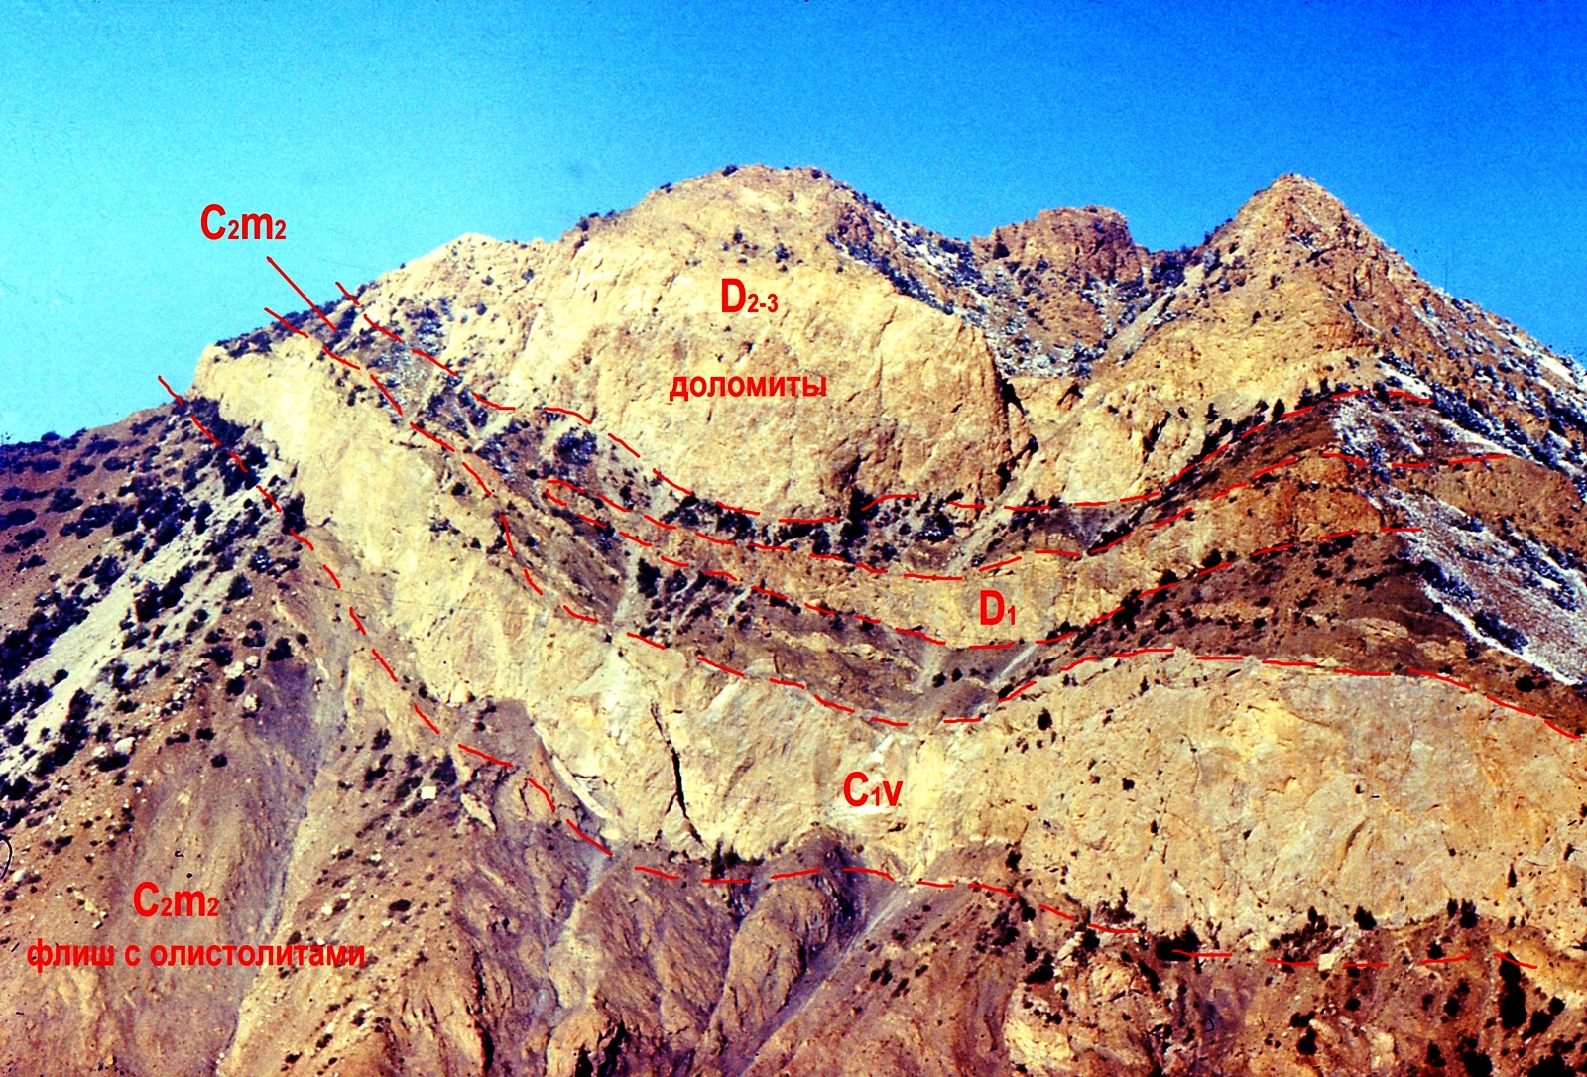
south
north
foredeep
Karavshin nappes, Turkestan Range, Southern Kyrgyzstan

Slide 23
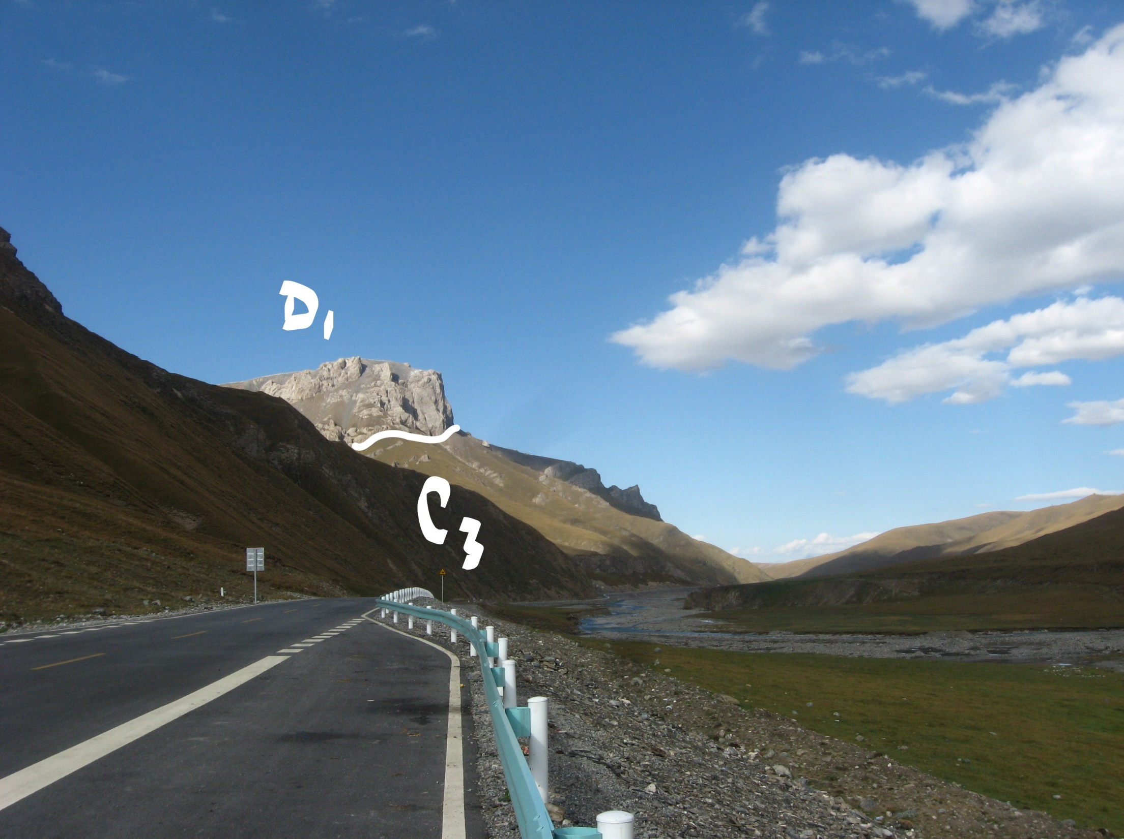
Telemet nappe in the Harke mountains, Chinese Southern Tian-Shan
Thank you – and go ahead!

