Slide 1
Porphyry Cu(Mo,Au) deposits of the Urals as sources of critical metals
Olga Plotinskaya IGEM RAS, Moscow
Anatoly I. Grabezhev IGG UB RAS, Yekaterinburg
Vera Abramova IGEM RAS, Moscow
Reimar Seltmann & John Spratt NHM

Slide 2
+ ca. 50% of Mo
100% of Re!

Slide 3
Outlines
Geotectonic setting
General geology of selected deposits
Molybdenite chemistry and Re distribution
Au-Ag mineralogy

Slide 4
Methodology
Bulk analyses
Single grain analyses
Study of molybdenite assemblages and selection of suitable grains;
SEM+EDS study of mineral inclusions;
X-ray mapping of molybdenite ReL_{α}, ReM_{α}, MoL_{α}, SK_{α}, CaK_{α}, SiK_{α}, FeK_{α}, and ZnK_{α};
EMPA point analyses (Cameca SX-100);
LA-ICP-MS study
Re & Mo in bulk ore samples: spectrophotometry (Ural Geological Survey), 1990th) & ICP-MS (IGG UrB RAS);
Calculation of Re content in molybdenite;
Re in molybdenite separates during Re-Os dating (Svetlana Tessalina, Curtin University)
Statistical analyses

Slide 5
LA-ICP-MS study
New Wave 213UP laser + Thermo X Series2 quadrupole ICP-MS
(IGEM RAS)
Isotopes measured: Si²⁹, S³³, Fe⁵⁷, Co⁵⁹, Ni⁶⁰, Cu⁶⁵, Zn⁶⁶, As⁷⁵, Se⁷⁷, Mo⁹⁵, Ag¹⁰⁷, Sn¹¹⁸,Sb¹²¹,Te¹²⁵, W¹⁸², Au¹⁹⁷, Pb²⁰⁸, Bi²⁰⁹, Re¹⁸⁵, Re¹⁸⁷ (=Os¹⁸⁷)
External standards:
for Re, Ag, Au: in-house pyrrhotite standard Fe_{0.9}S, method by Wohlgemuth-Ueberwasser et al. (2007)
MASS-1 (USGS) for the remaining elements
Internal standard: ³³S based on molybdenite stoichiometry (40 wt.%)
Conditions: line profiles 40 μm, 5 μm/s ablation speed, laser frequency 15 Hz, 5-7mJ input power, 30 s for background and washout
Data processing – Iolite software v. 2.5
External control: comparison with EMPA and/or bulk analyses for Re

Slide 7
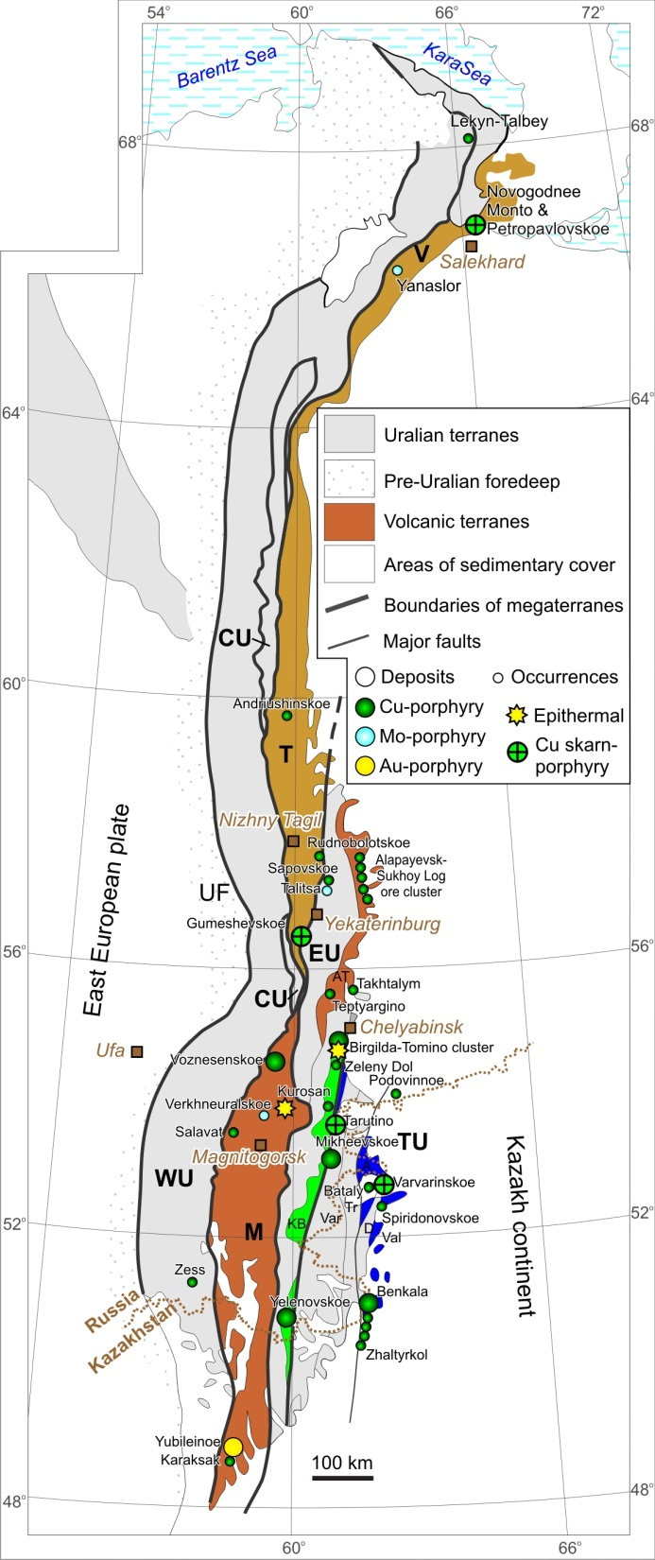
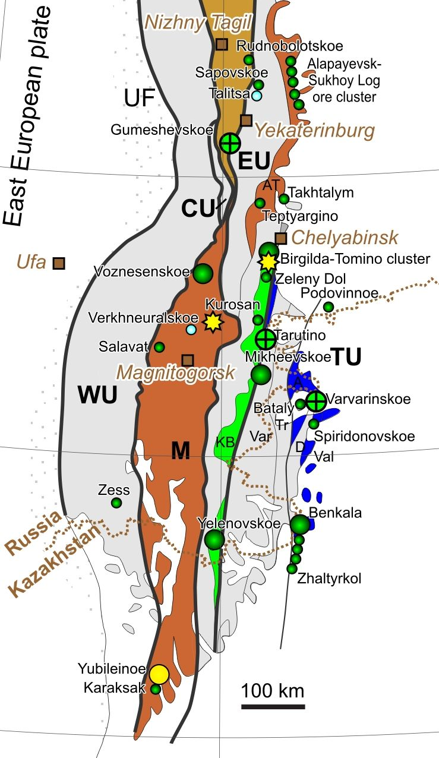
Tagyl
Magnitogorsk
S, D₁₋₂
East Uralian
volcanic
S, D₂-C
Trans-Uralian
(Valerianovka arc)
C₂₋₃

Slide 8
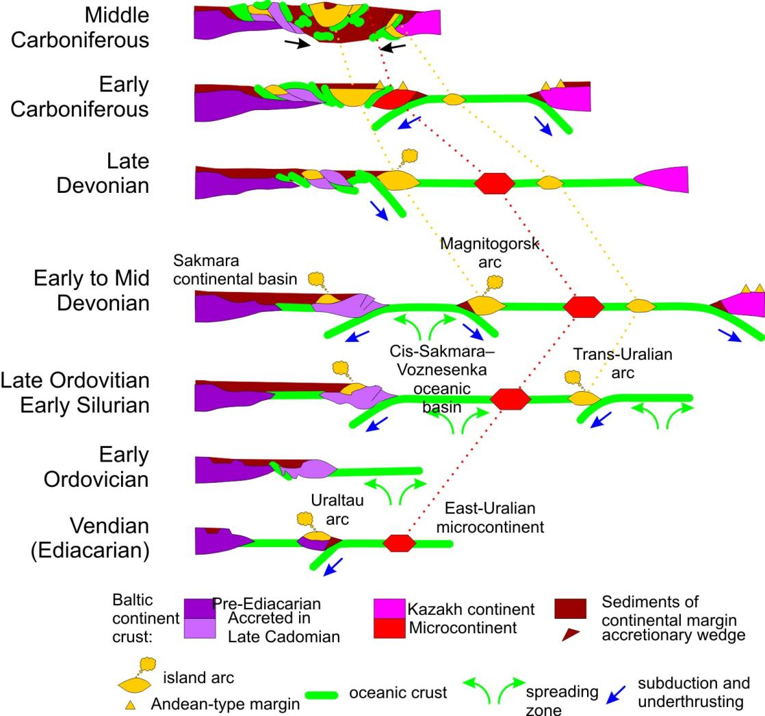
Simplified tectonic evolution of the South Urals after Samygin & Burtman, 2009
Late
Kazakh
Birgilda-Tomino
porphyry Cu
~ 430 Ma
Europe
?

Slide 9
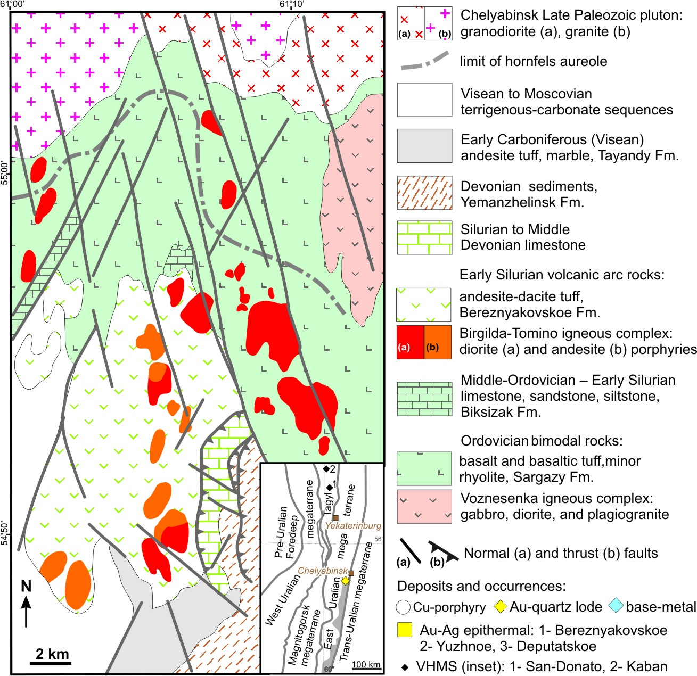
Birgilda-Tomino ore cluster
Birgilda
North Tomino
Biksizak
Tomino
Michurino
Kalinovskoe
Bereznyakovskoe
ore field
modified after (Grabezhev et al., 2000)

Slide 10
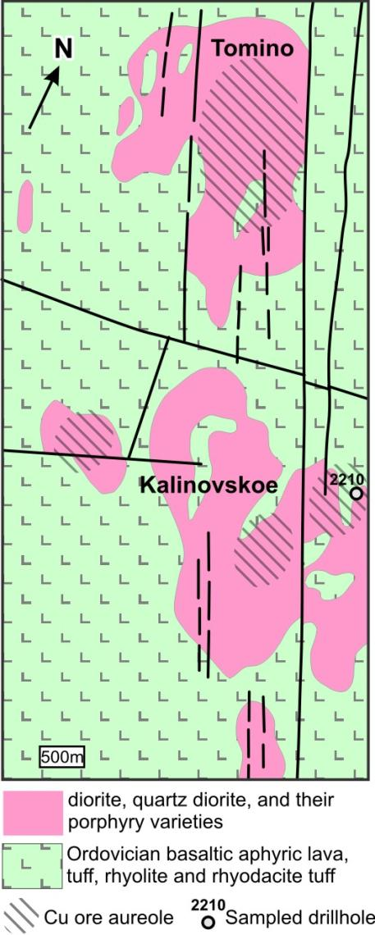
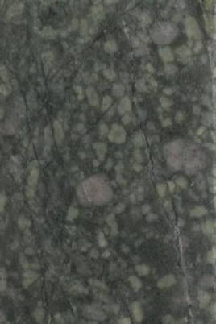
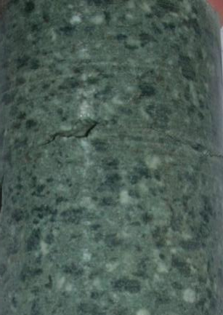
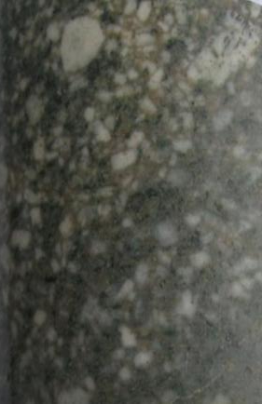
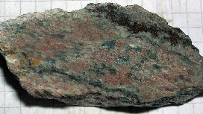
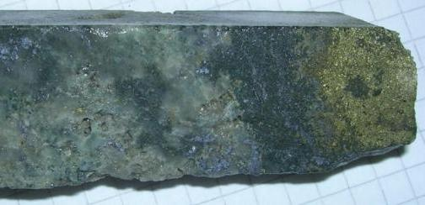
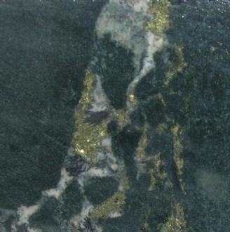
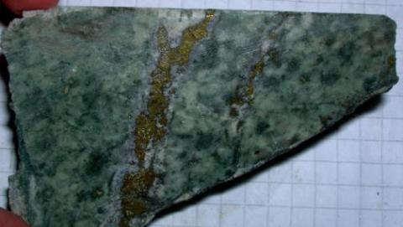
428 ± 3 Ma, SHRIMP (Grabezhev et al., 2013)
430.4 ± 2.0 Ma, Re-Os (Tessalina & Plotinskaya, 2017)
Qtz-Pl
diorite
porphyry
Seriate
diorite
porphyry
Hbl-Pl diorite
porphyry
Q, Bn+Cp (Bi)
Q, Cp (Chl, Ep, Car)
1,54 Mt Cu
(331 Mt @ 0.47 Cu),
Au 0.12 ppm
Q, Mo (Q+Ab+Ser)
Q, Carb Cp, Mt, Hem (Chl, Ep, Car)
Q, Cp (Q+Ser)

Slide 11
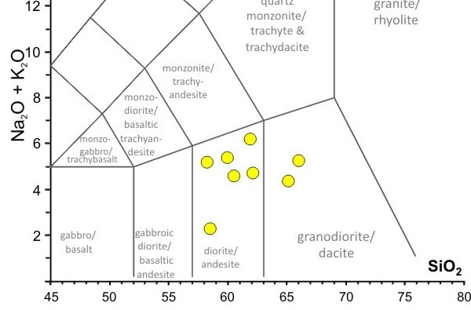
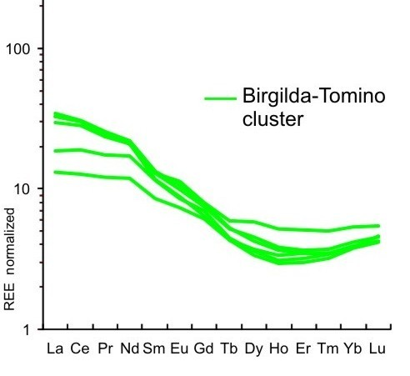
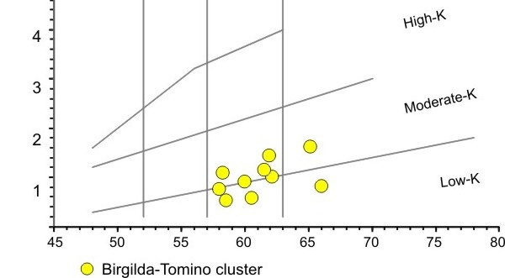
K₂O

Slide 12
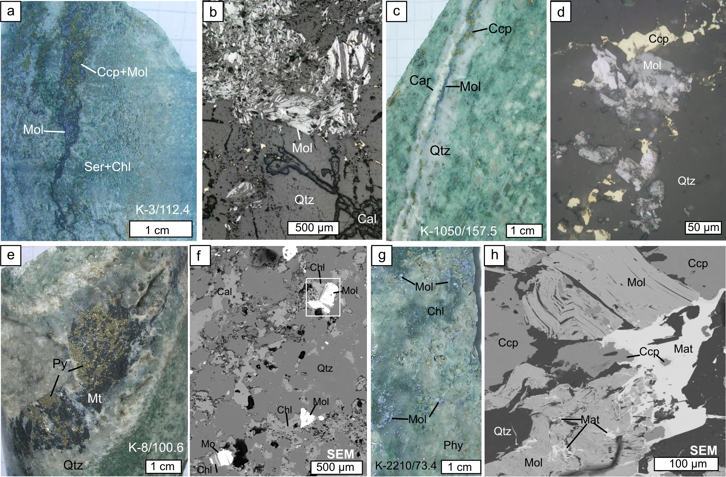
Mo-bearing samples, Kalinovskoe
431.9±1.9 Ma
431.7±1.7Ma

Slide 13
EMPA + LA-ICP-MS
Re 81.5ppm (Tessalina and Plotinskaya, 2017)
Geom. mean = 75 ppm Re

Slide 14
EMPA + LA-ICP-MS

Slide 15
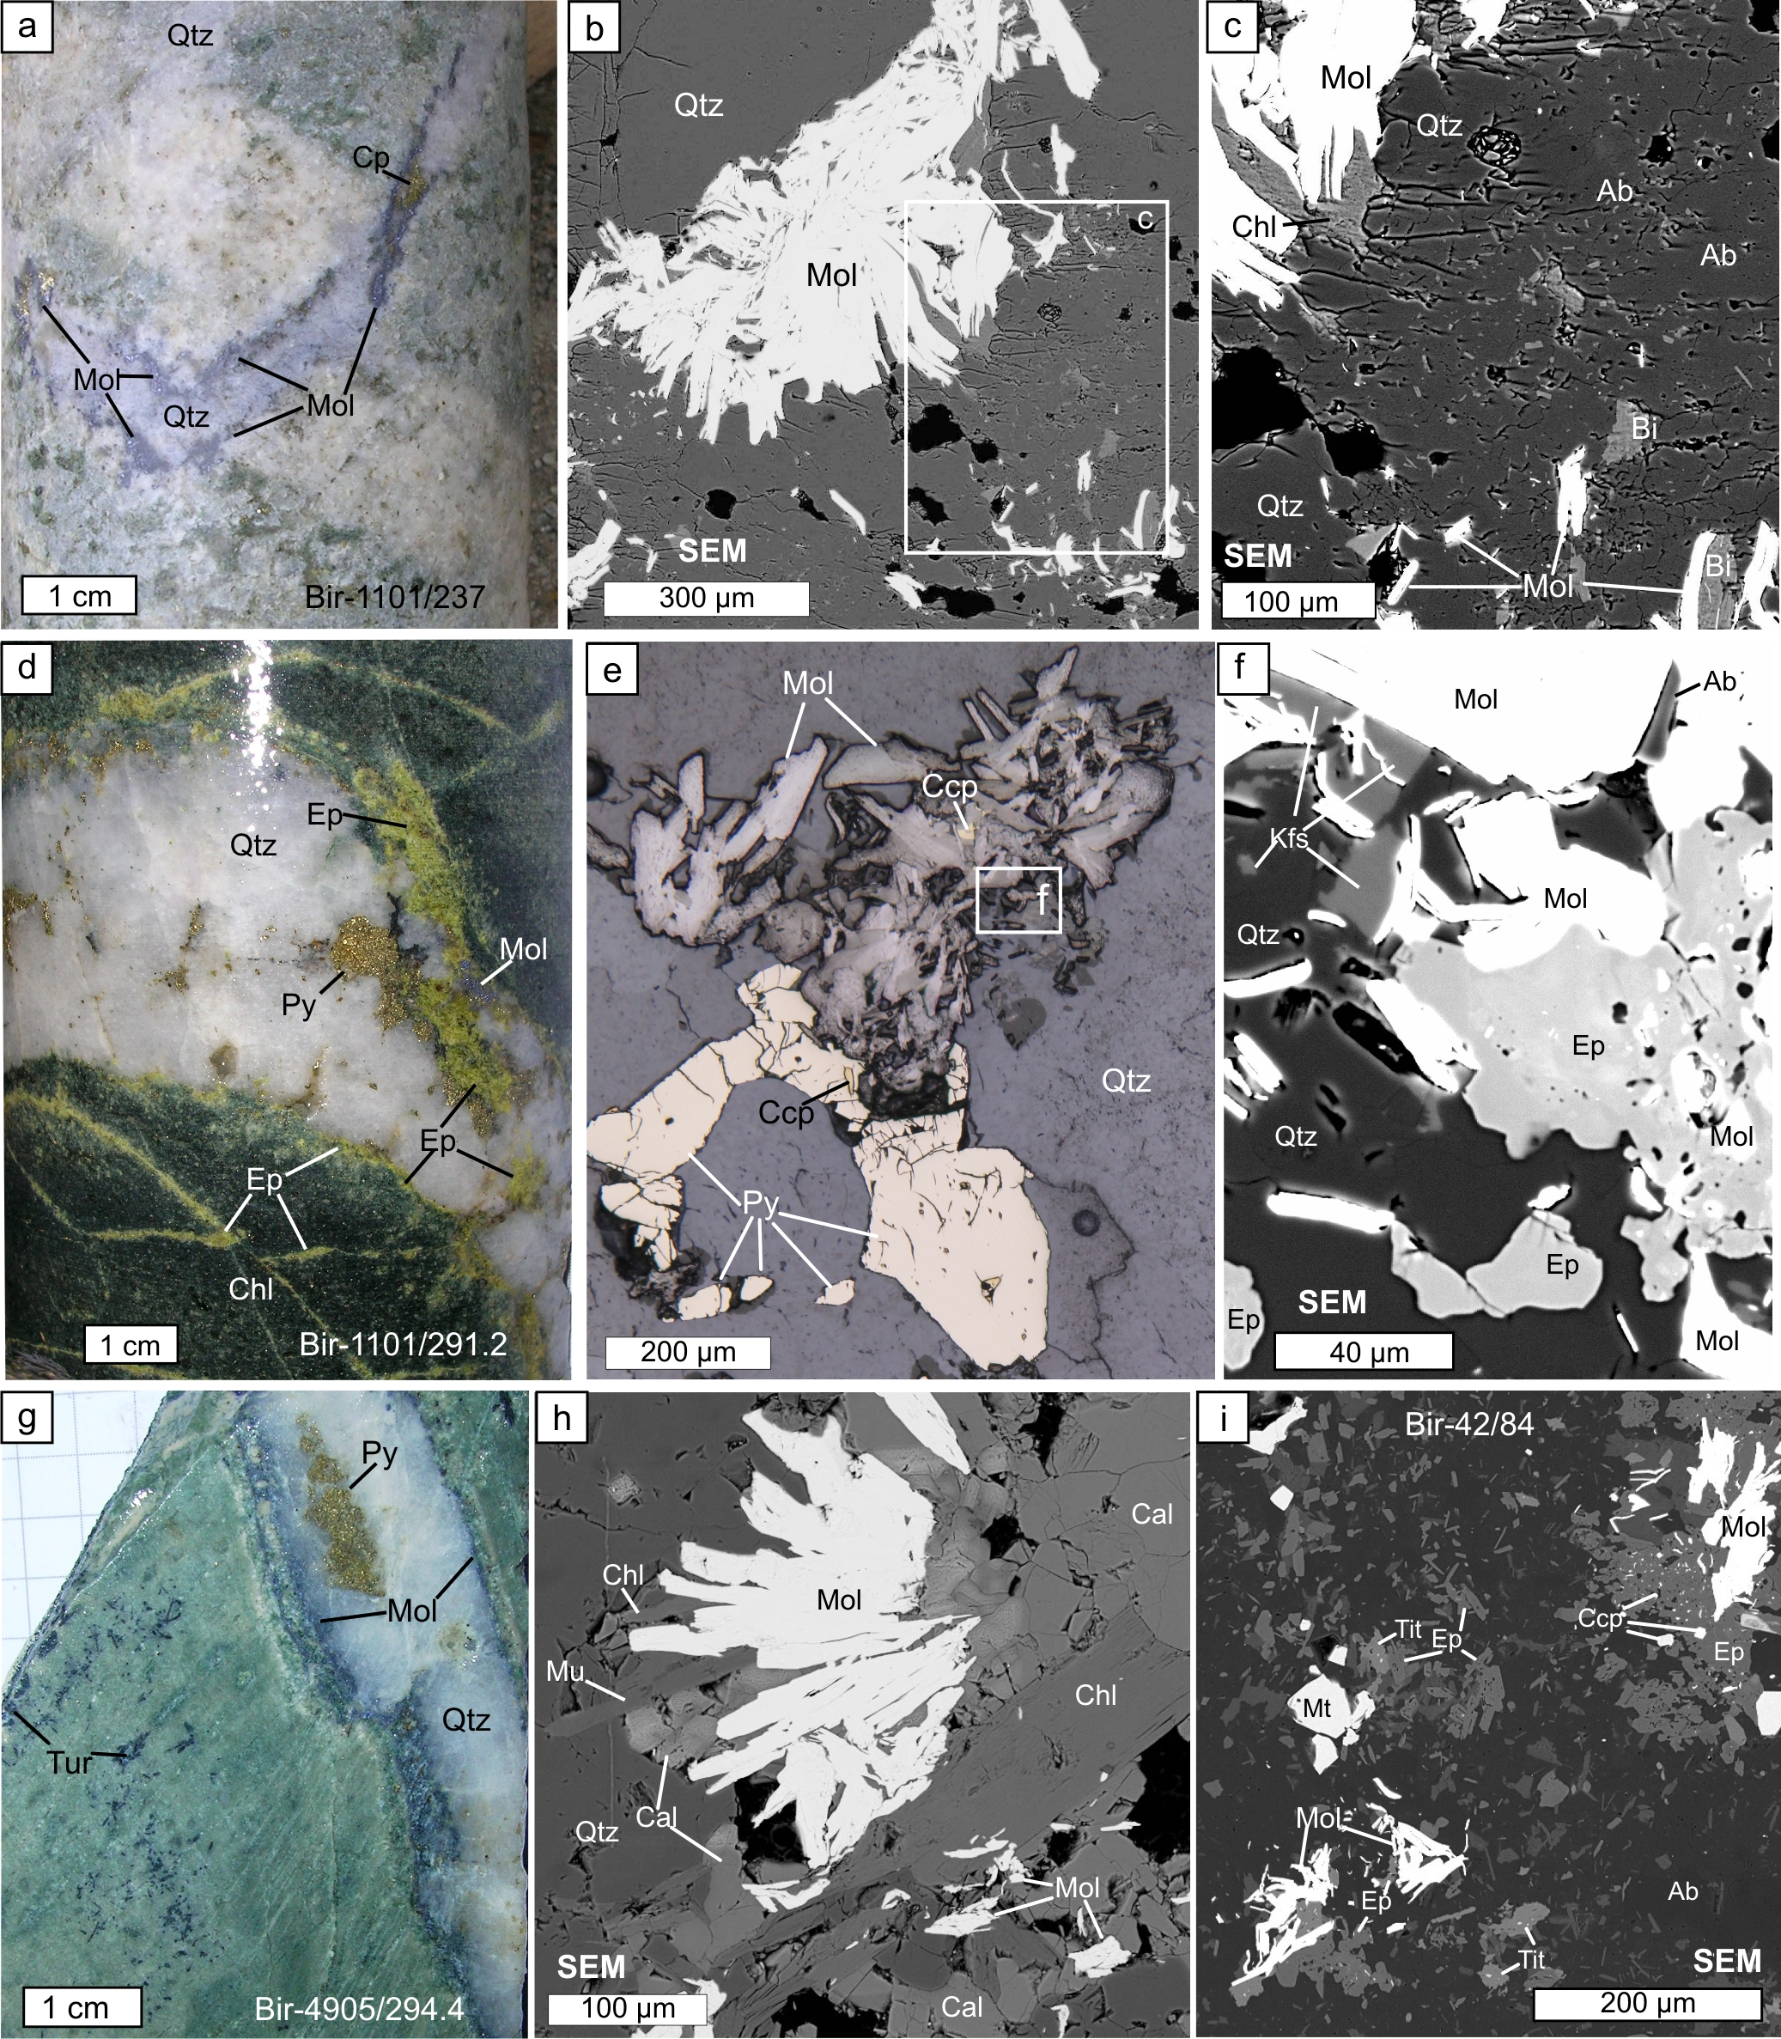
Mo-bearing samples, Birgilda
432.0±1.7Ma

Slide 16
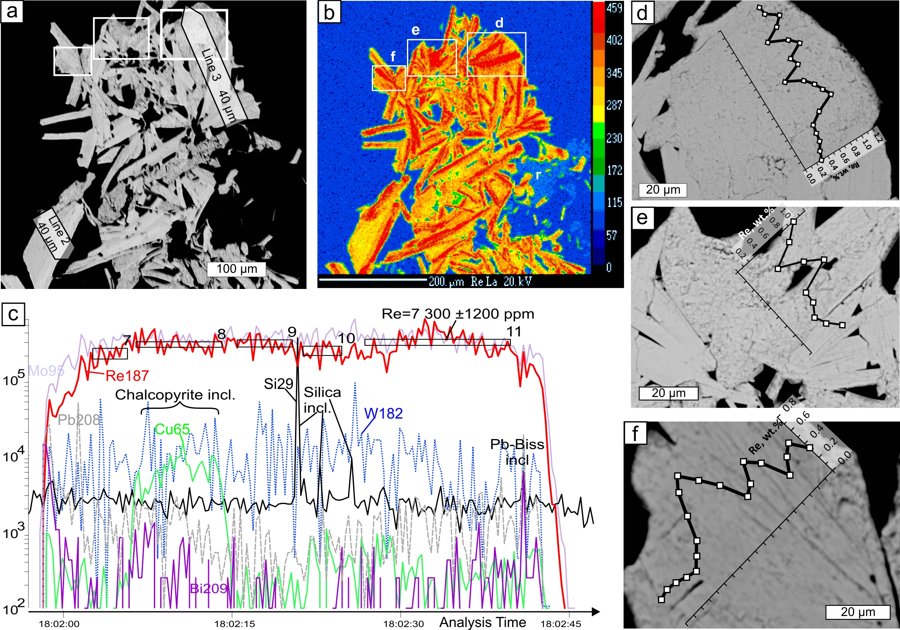
EMPA + LA-ICP-MS

Slide 17
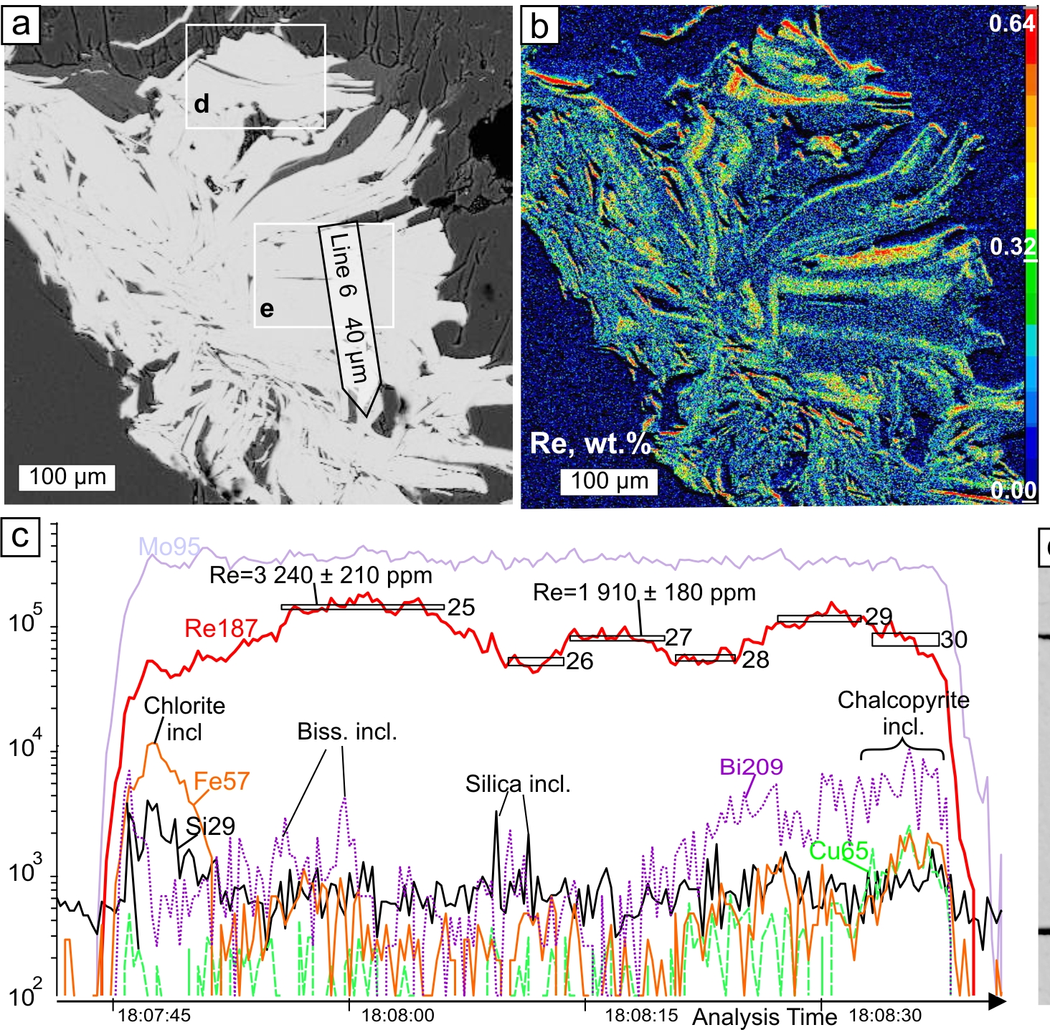
Birgilda: EMPA + LA-ICP-MS

Slide 18
LA-ICP-MS

Slide 19
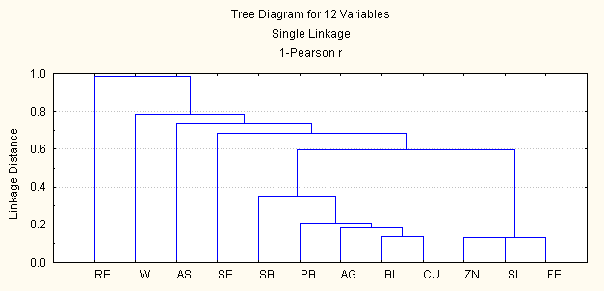
Kalinovskoe
Mineral inclusions
Significant
r = 0.42
Isomorphic impurities
or/and
Mineral inclusions

Slide 20
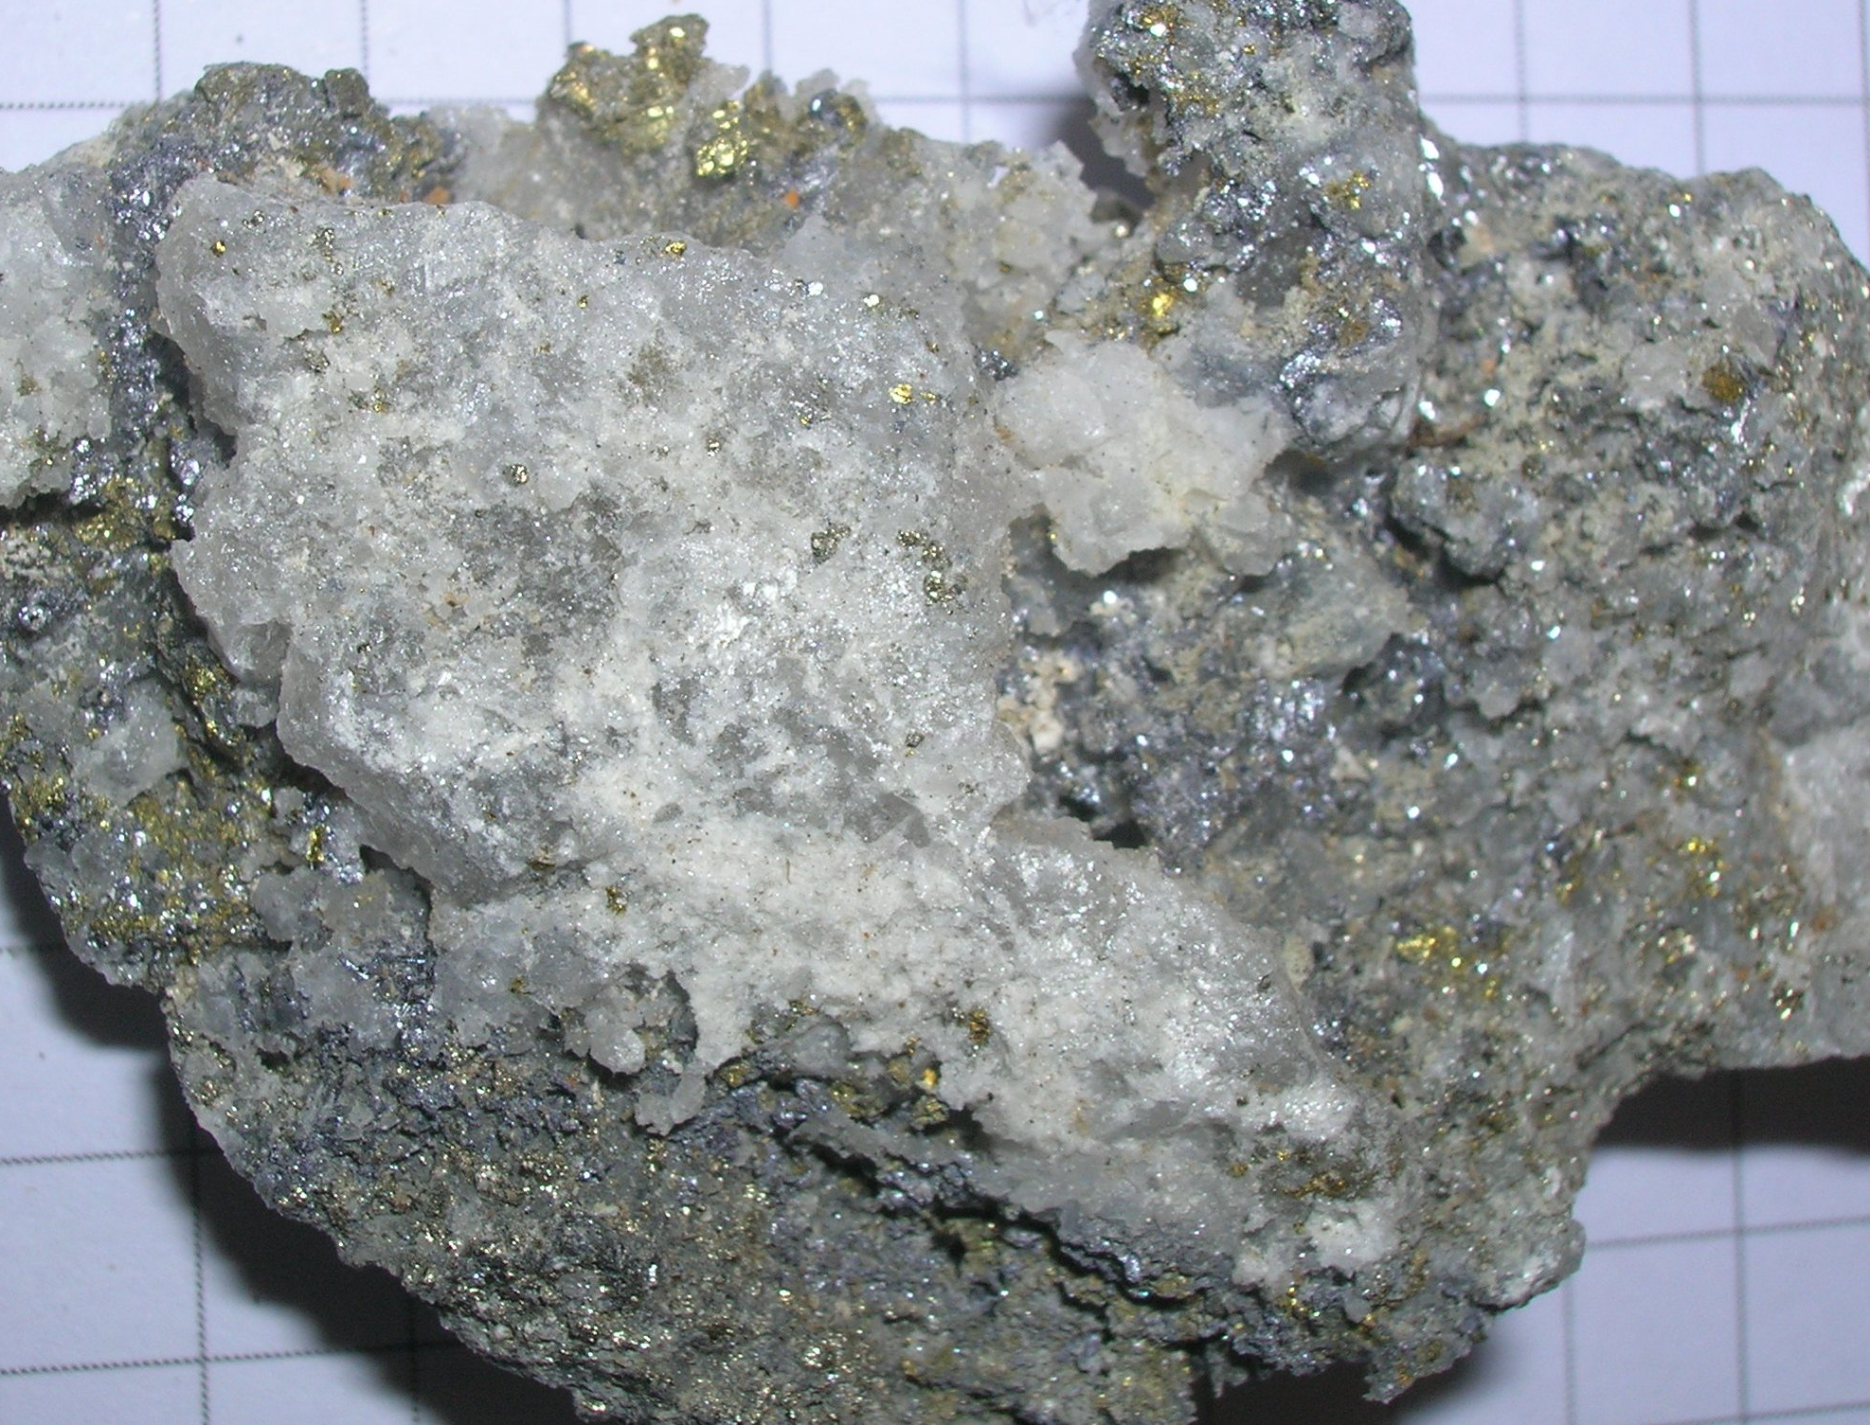
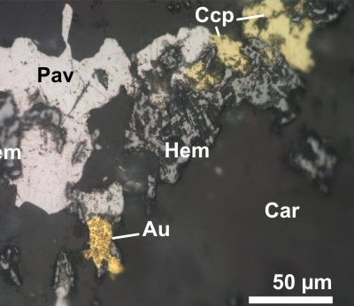
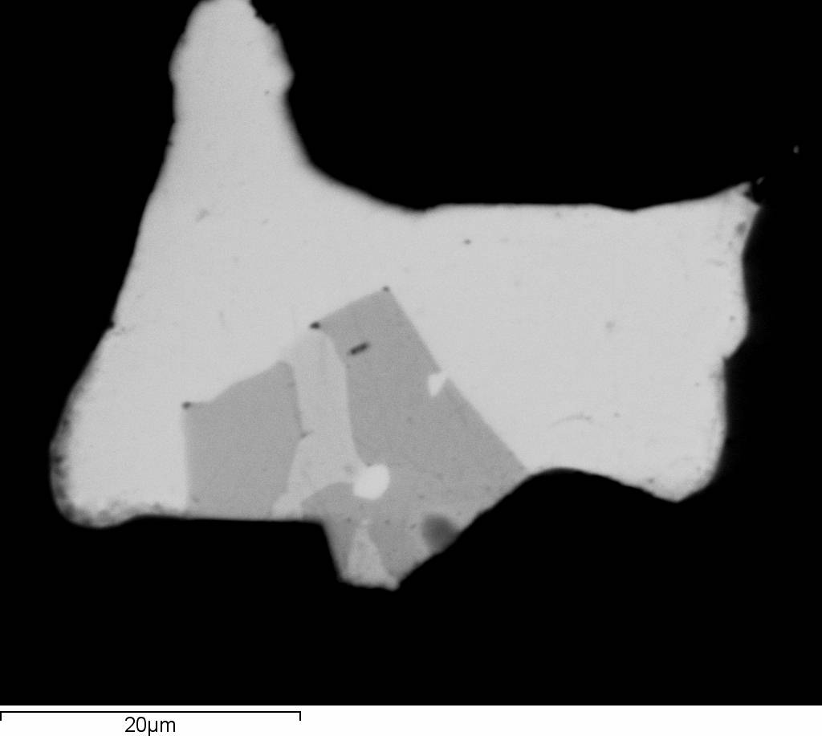
Au-Ag minerals
Porphyry-style
Argillic
Epithermal
stutzite
Ag5Te3
hessite
Ag2Te
Gn
altaite
PbTe
petzite
Ag3AuTe2

Slide 21
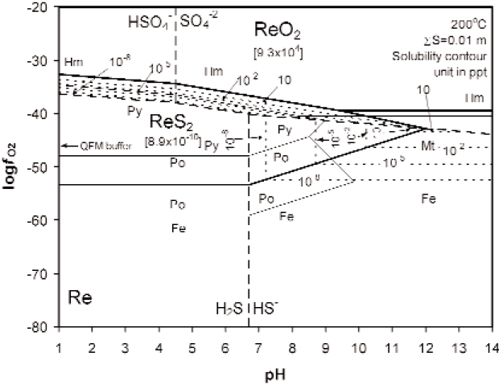
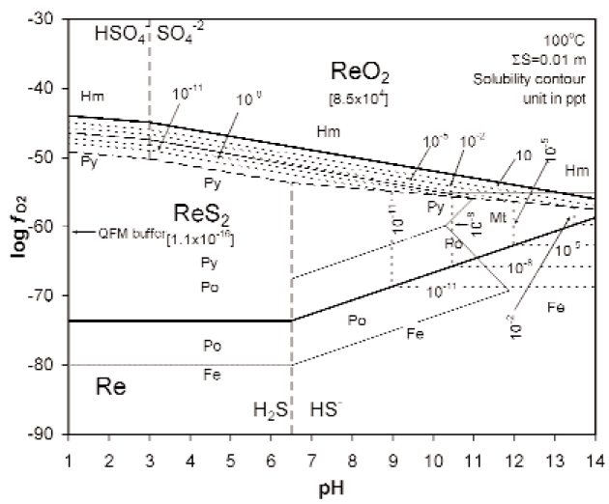
Re in molybdenite
Xiong et al., 2006
Deposition of ReS₂:
f_{O2} in pyrite stability space
рН decrease
Т decrease
Mass balance
(Stein et al., 2001) ???
Primary magma enrichment
(Sun et al., 2003)???

Slide 22
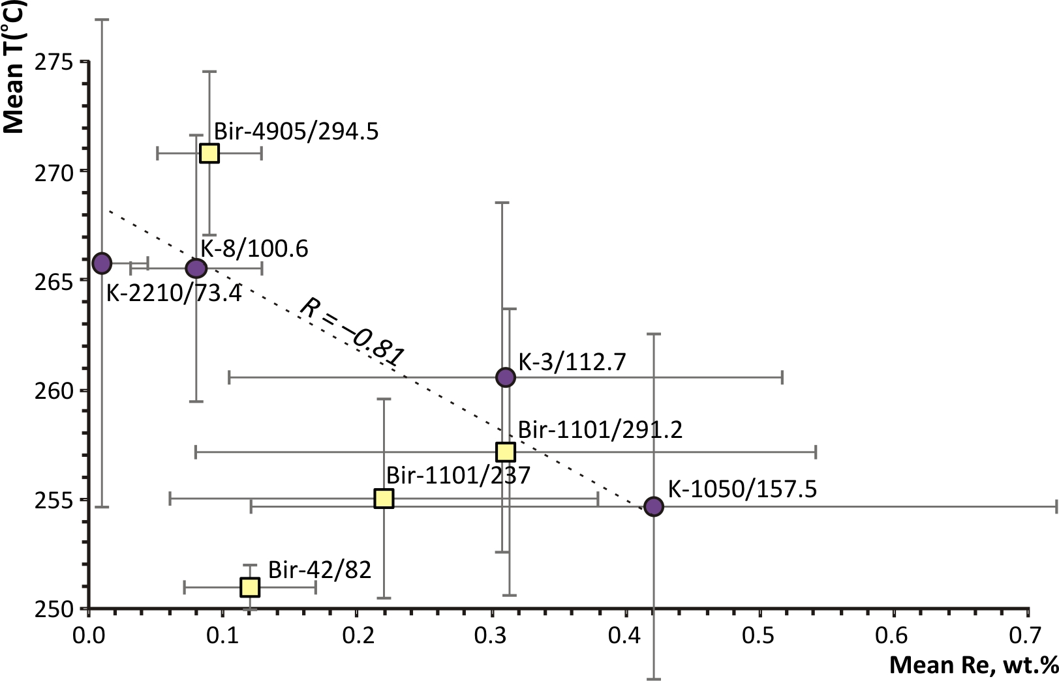
T vs. Re contents (EMPA)
Chlorite
geothermometry

Slide 23
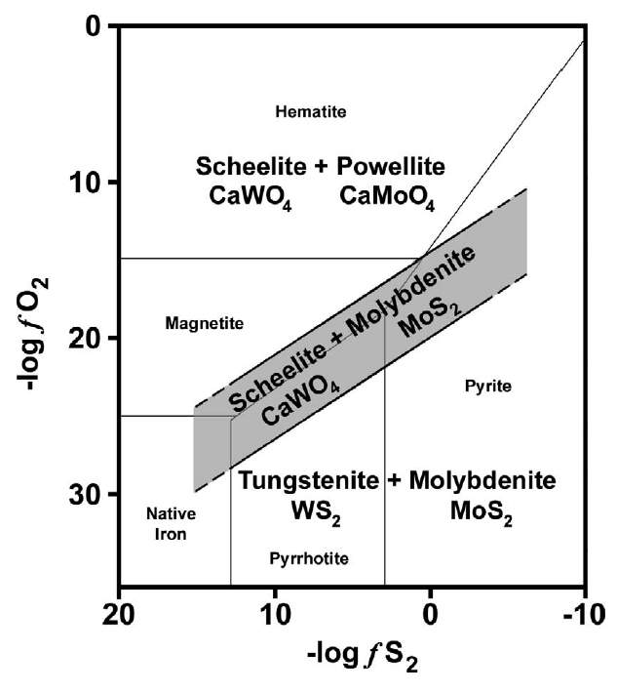
W in molybdenite
577ºC & 1000 bars
(modified from Hsu, 1977)
NB High T is favorable
for W incorporation
in molybdenite
Initial enrichment
of the fluid in W?

Slide 24
Simplified tectonic evolution of the South Urals after Samygin & Burtman, 2009
Late
VerkhneUralskoe Mo
Cu/Mo ~ 15
~ 340 Ma
Kazakh
Yubileinoe Au
Voznesenskoe Cu
Cu/Mo ~ 200
380 Ma
Europe
Salavat Cu
Cu/Mo ~ 600

Slide 25
Voznesenskoe
Verkhne-Uralskoe
Salavat
Yubileinoe

Slide 26
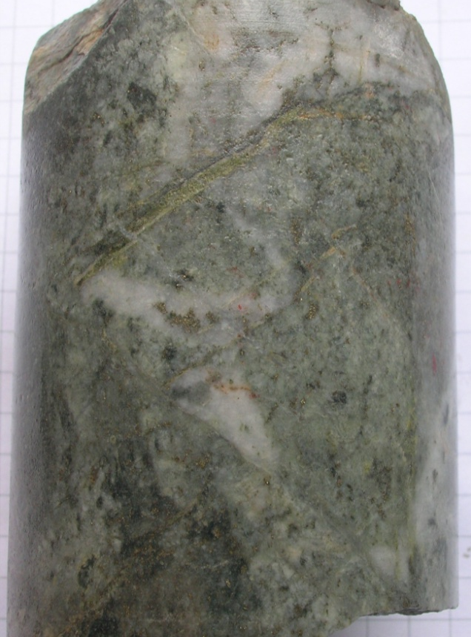
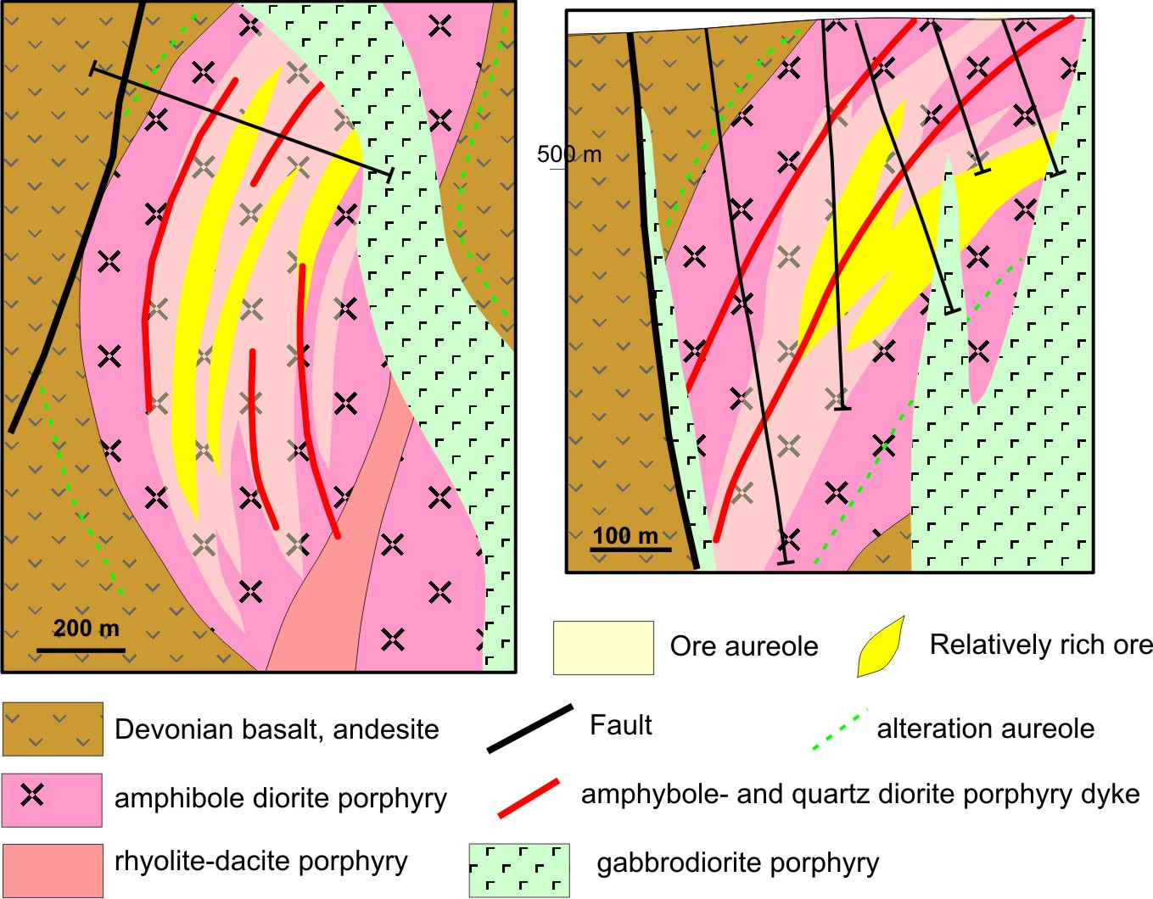
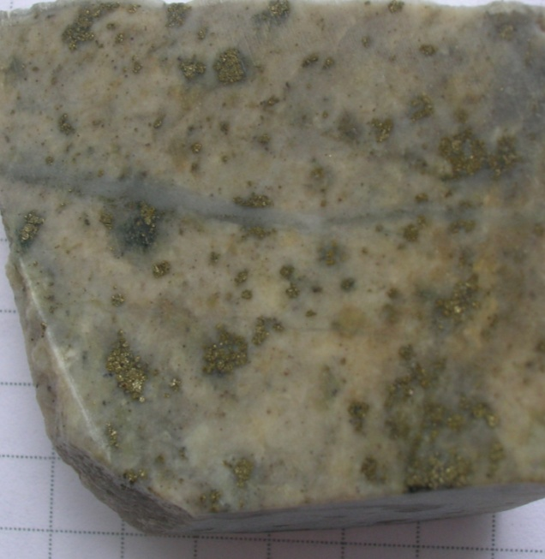
The Salavat deposit (after Minina, 1982)
Ivanov et al., 2016:
probable reserves (P1) 993 kt Cu @ 0.48%
Cu/Mo = 600;
Mo max 0.07
Middle Devonian from geological estimations
(hosted by Lower to Middle Devonian Irendyck Formation

Slide 27
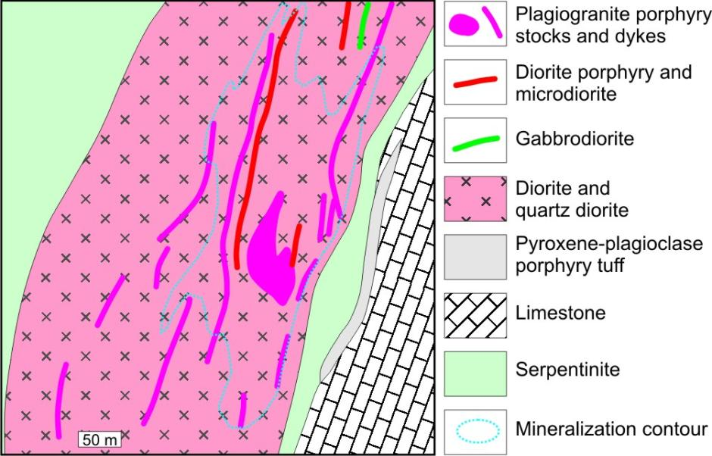
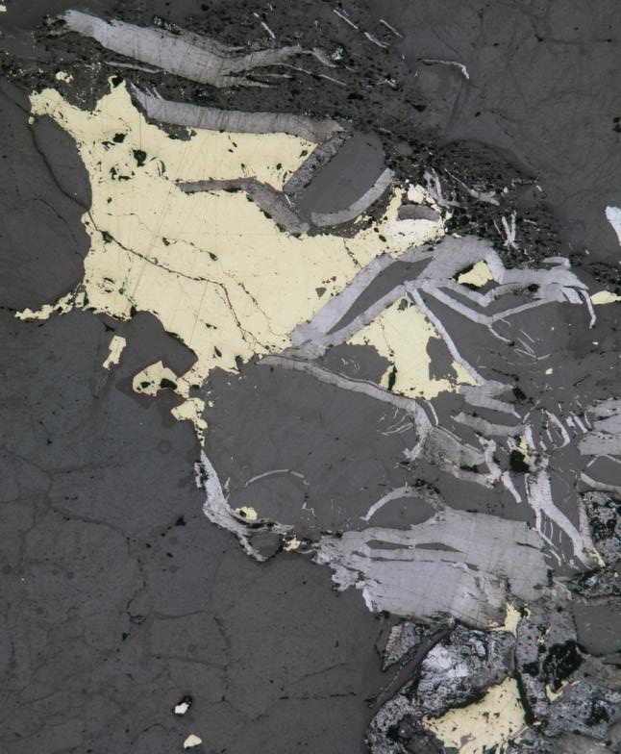
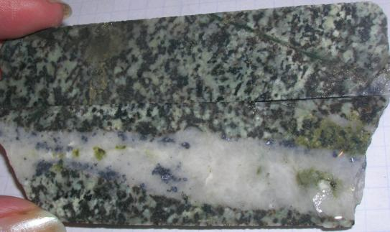
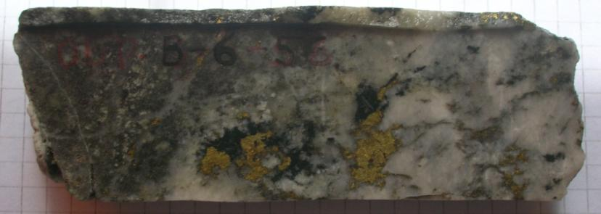
Voznesenskoe Cu porphyry deposit
Mo- quartz veins
Py-Ccp
Py-base-metal quartz veins
Py
Cu/Mo ~ 250
381 ± 5 Ma,
U-Pb SHRIMP-II
Grabezhev & Ronkin, 2011
Py-Ccp
Py

Slide 28
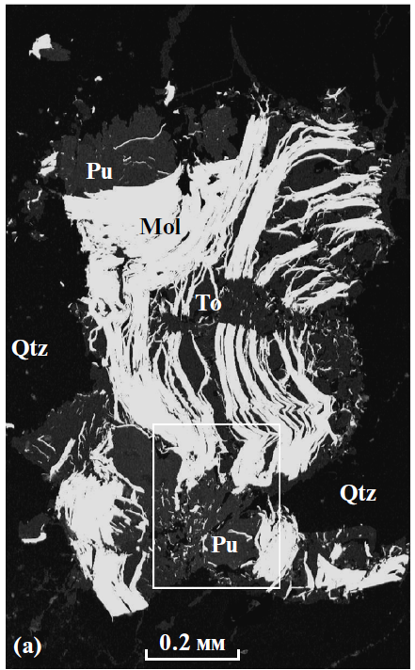
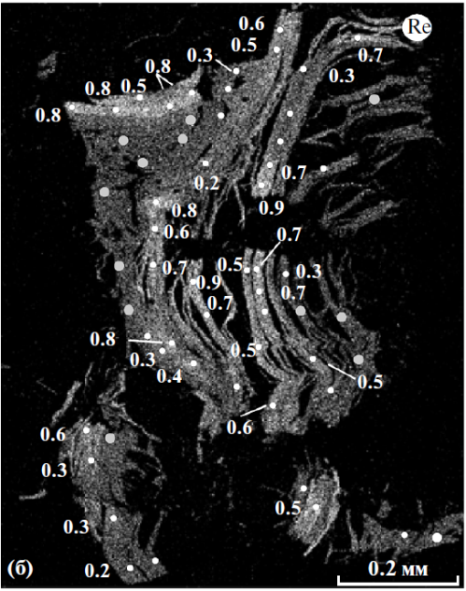
Voznesenskoe Re in moly
(Grabezhev & Voudoris, 2014)
Calculated- 1470 ppm
(Grabezhev, 2013)

Slide 29
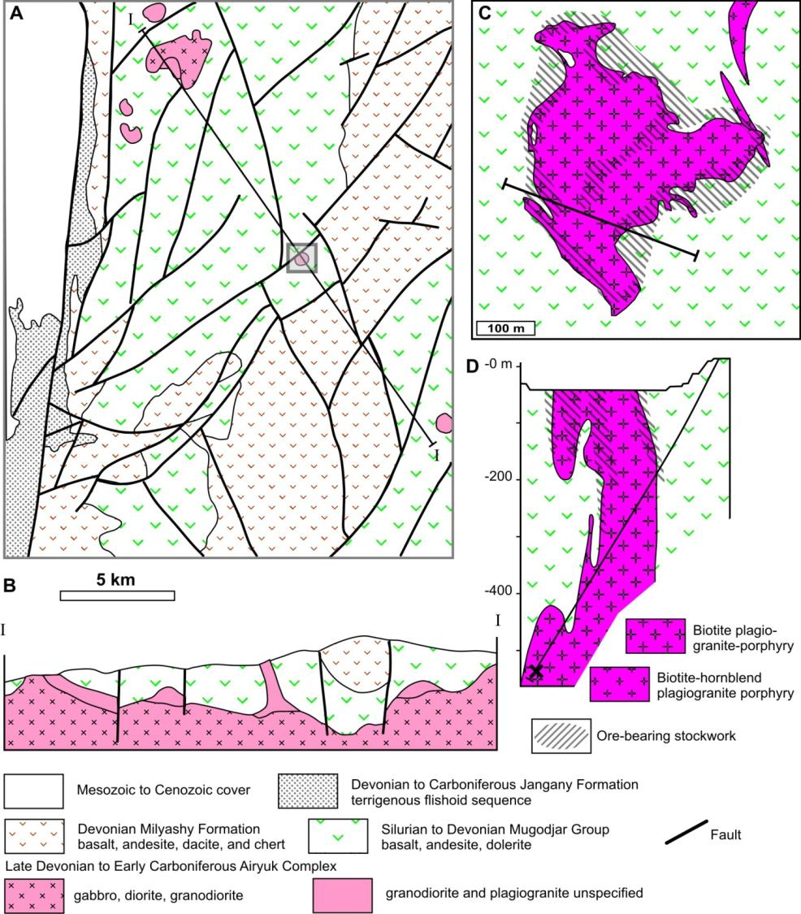
Yubileinoe Au-porphyry
Sun Gold (2013):
82.8 Mt at 1.7 g/t Au and 0.15% Cu for 4.59 Moz Au (~130t)
Naraveit et al., 1974; Grabezhev and Belgorodskii, 1992; Seltmann et al., 2014;

Slide 30
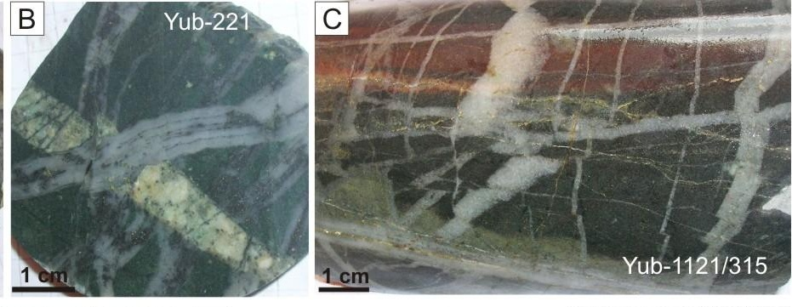
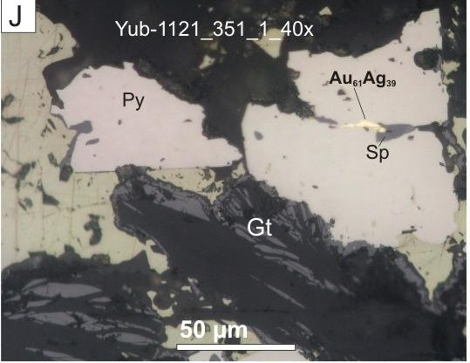
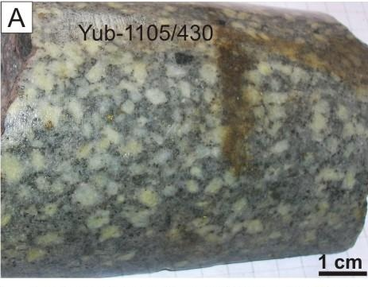
374± Ma, U-Pb in zircons
(Grabezhev, 2014)

Slide 31
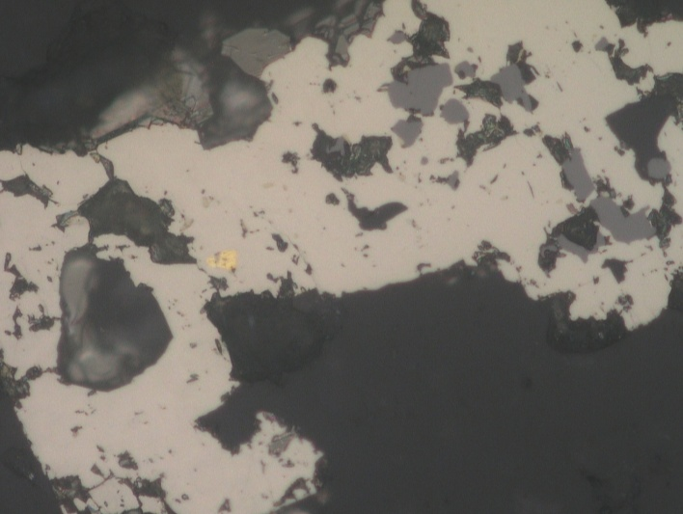
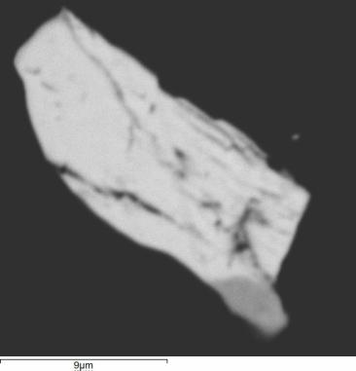
Ru
Py
racklijeite
(Bi,Pb)₃Te₄
Bi₂Te₂(S,Se)
Au 870
Ag₂Te

Slide 32
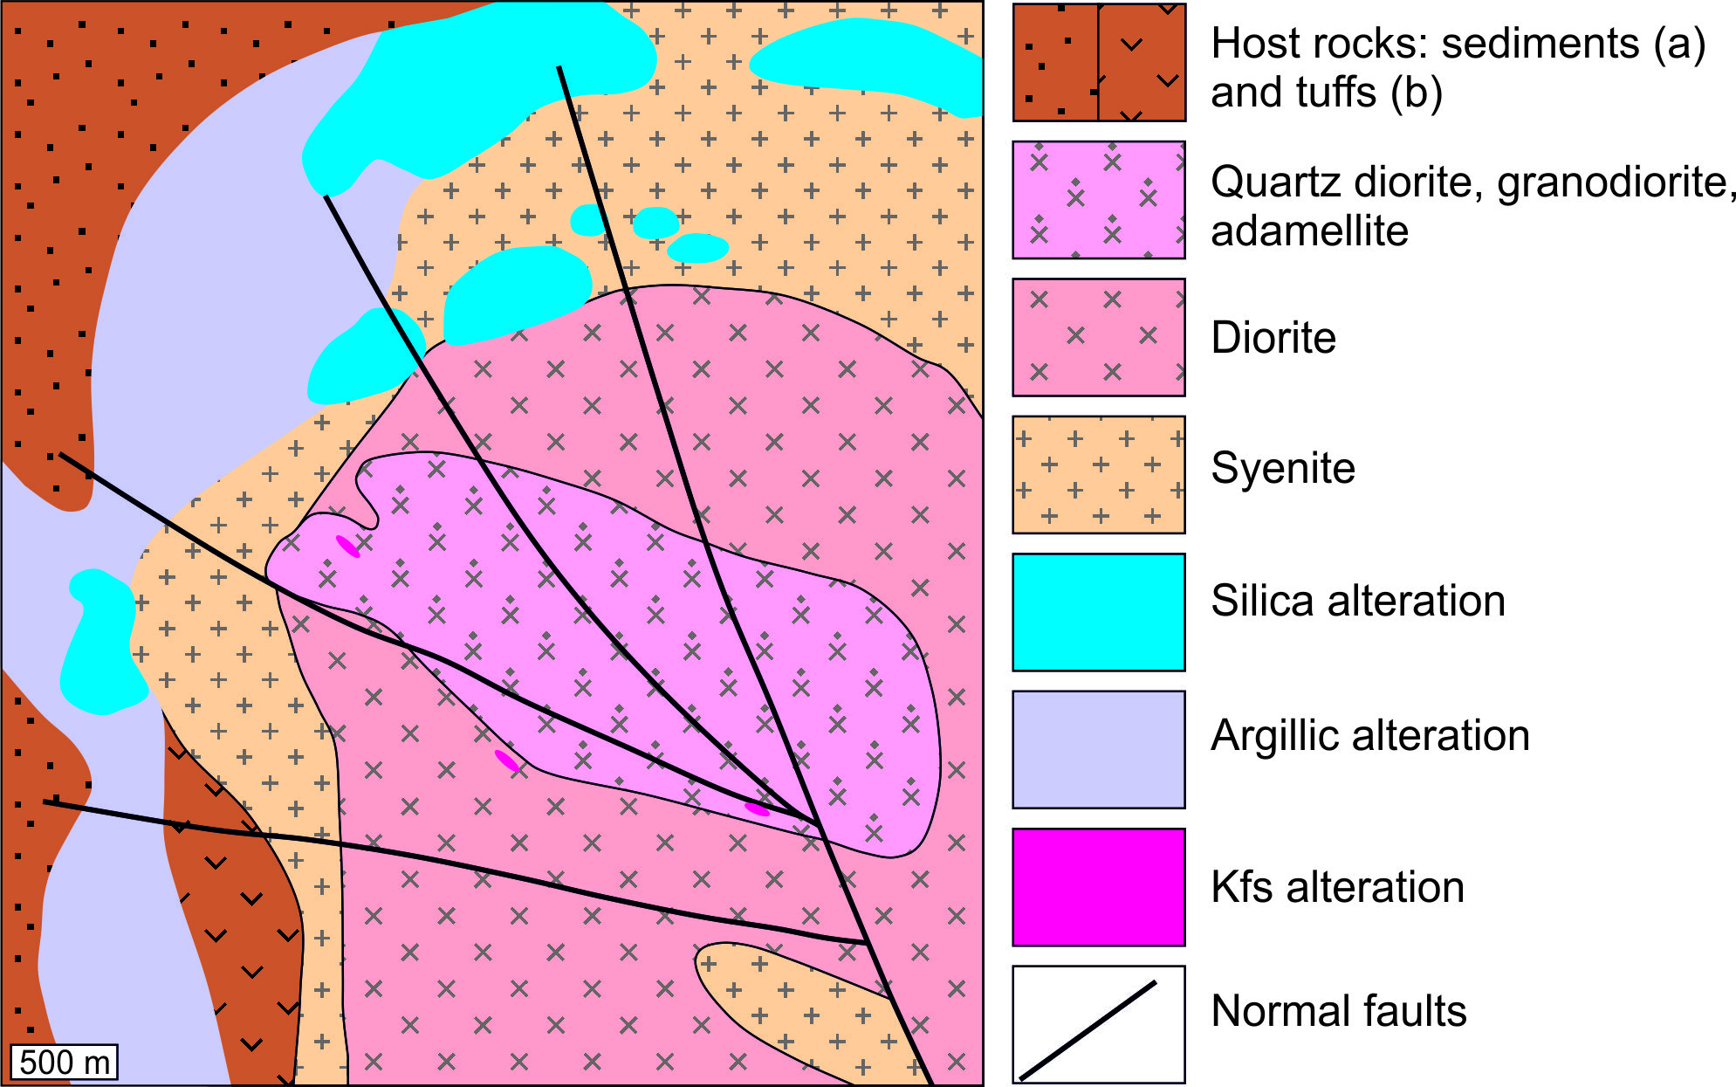
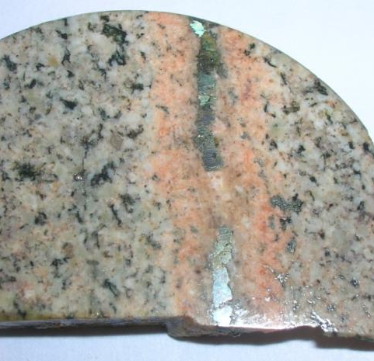
Verkhneuralskoe Mo porphyry
Unknown potential
Cu/Mo ~ 15
341 ± 1 Ma, Rb-Sr (Salikhov et al., 1994)
Upper Famennian host rocks

Slide 33
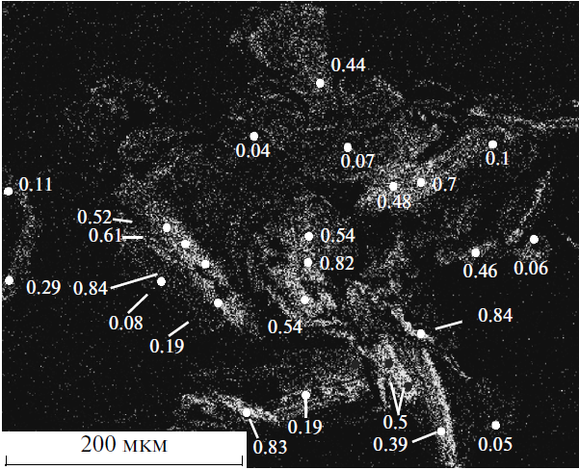
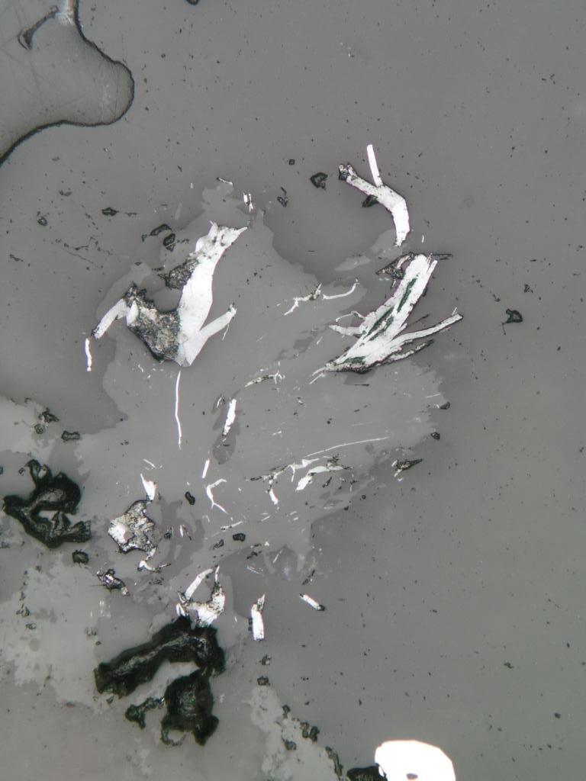
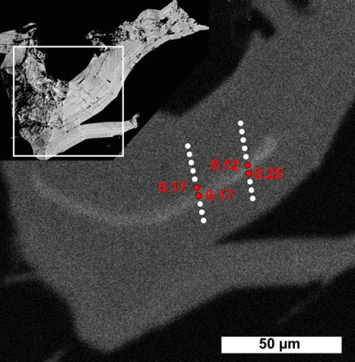
Verkhne-Uralskoe Re in moly
Calculated: 240-3140 ppm
(Grabezhev, 2013)
Ep
Qtz
Py

Slide 34
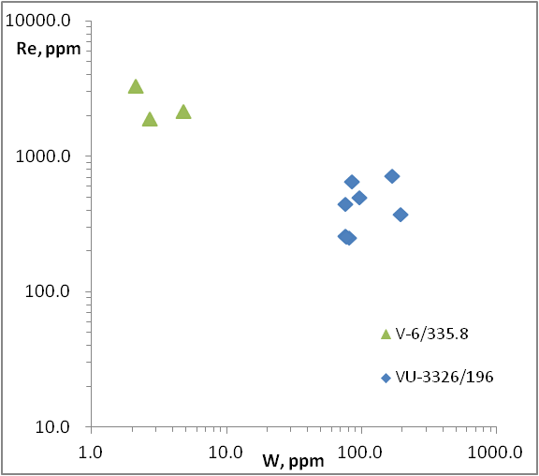
LA-ICP-MS (first data)

Slide 35
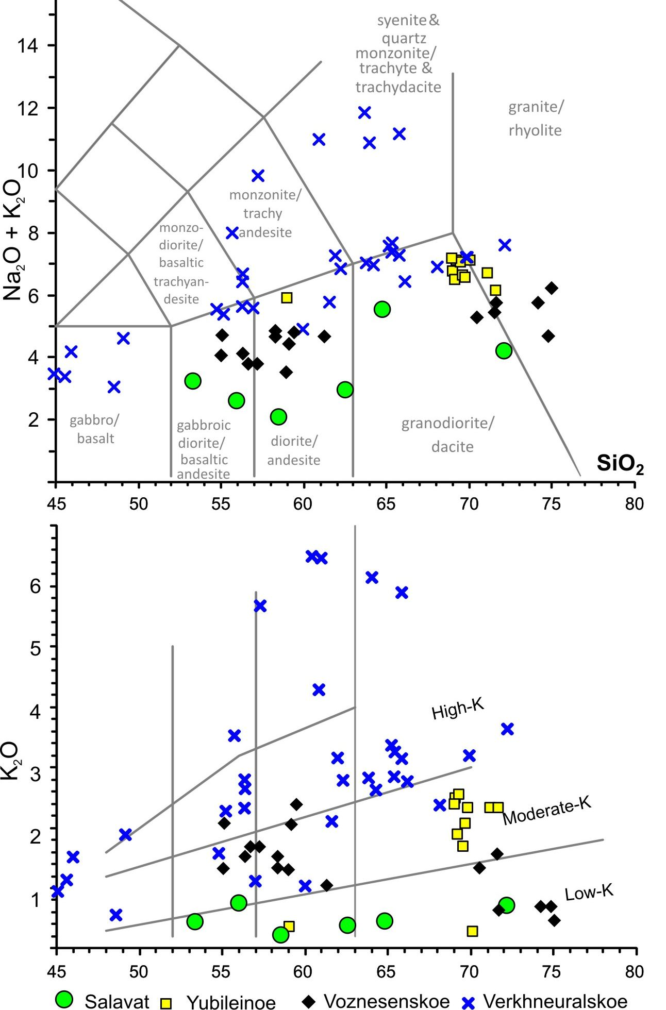

Slide 36
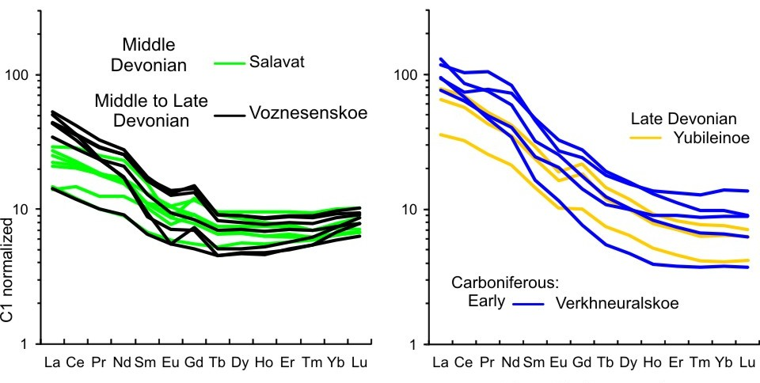
Salavat

Slide 37
Magnitogorsk arc

Slide 38
Cu/Mo=15
Cu/Mo=200
Cu/Mo~150
Modified from Kay and Mpodozis (2001);
Zarasvandi et al. (2016).

Slide 39
Talitsa Mo ~ 300 Ma
Late
Late
Benkala Cu ~ 335 Ma
?
Mikheevskoe Cu
~ 360 Ma
Europe
Kazakh

Slide 40
East-Uralian
Carboniferous
Trans-Uralian
Late Devonian-
Carboniferous

Slide 41
(after Shargorodsky et al., 2005)
Mikheevskoe
(Mo)-Cu
porphyry
deposit
Measured resources:
385 Mt @
0.43 % Cu,
0.0037 % Mo,
0.037 ppm Re,
0.12 ppm Au
1.7 Mt Cu
14 kt Mo
14 t Re
47 t Au

Slide 42
Diorite
Quartz diorite
porphyry
356 ± 6 Ma, SHRIMP
(Grabezhev & Ronkin, 2011)
357.8 ± 1.8 Ma and
356.1 ± 1.4 Ma,
Re-Os in molybdenite
(Tessalina & Plotinskaya, 2017)
Seriate diorite
porphyry
Post-ore
plagiogranite-
porphyry

Slide 43
Main ore and alteration types
I. “Inner” propylites
II. Bt-alteration
Mgt-Act alteration
Bt-Qtz veinlets, pervasive bt,
bornite & chalcopyrite dissemination
Qtz veinlets with
bornite & chalcopyrite
III. Phyllic
Quartz veinlets with Mo
V. Base-metal veins (Q, Tt, Gal, Sp)
IV. Propylites

Slide 44
molybdenite
Base-metal
mineralisation
Bn
Ccp+Ep
Mo
500 µm
50 µm
Car
Kfs_Qtz
Ep+Ccp
Bi
Ger
Ccp
Td
500 µm

Slide 45
Mo, Cu, Re in ores
Re in moly
Calculated: 231–3598 (mean 1349) ppm
Measured 289 − 3025 ppm
(Grabezhev, 2013; Plotinskaya et al., 2015)

Slide 46
Re in single moly grains: EMPA
“Spotty” distribution
“Linear” distribution

Slide 47
Concentric distribution

Slide 48
Re in single moly grains
Re in single moly grains

Slide 49
Precious metals Gold in bornite

Slide 50
Теллуриды в борните и халькопирите
Нарастают,
выполняют
трещинки
и поры!!!

Slide 51
PGE tellurides
merinskyite PdTe₂,
sopcheite Ag₄Pd₃Te₄

Slide 52
Native gold within base-metal stage
Presented by Yamshikov G.K.
Presented by Shargorodskii B.M.

Slide 53
Benkala
www.frontiermining.com:
1.56 Mt Cu (0.25% cut-off):
Cu/Mo ~ 100

Slide 54
Benkala
335 ± 3 Ma, LA-ICP-MS (Grabezhev et al., in press)

Slide 55
The Talitsa Mo-porphyry deposit
(after Uralgeologia PGO & Azovskova, Grabezhev, 2007)
Inferred resources:
129 Mt @ 0.055 % Mo ≈ 71 Tt Mo 0.11 % Cu ≈ 62 Tt Cu

Slide 56
Qtz-Mo-(Py) stage (Kfs)
Base-metal (Phyllic)
297.4 ± 2.3 Ma, SHRIMP
(Smirnov V.N. et al., 2017)
298.3 ± 1.3 Ma, Re-Os
(Tessalina and Plotinskaya, 2016)

Slide 57
Re-poor molybdenite
Re in Moly
187 ppm (Grabezhev, 2013)
17-27 ppm
(Tessalina & Plotinskaya, 2017)
Qtz
Ms-Phng
Kfs-related
Kfs
Kfs
Phyllic-related
T+
200 µm

Slide 58
K₂O

Slide 60
Trans-Uralian arcs

Slide 61
Cu/Mo~100
Cu/Mo=2
Cu/Mo=120
Modified from Kay and Mpodozis (2001); Zarasvandi et al. (2016).

Slide 62
Mass balance?
Grabezhev, 2013
porphyry Mo
porphyry Cu

Slide 63
What’s next?
Mo
Late
Cu
Volcanic arc terranes of the Urals have a good potential
for porphyry (and related) mineralization

Slide 64
Preliminary data
Sialic basement
Carb-Perm
collision
oceanic arc
Mantle
Carboni-
ferous
Andean-type
Mafic basement
collision
Magnitogorsk
Devonian arc
oceanic arc
Mixed
Silurian arc
Crustal
Mao et al. (2013) and Pasava et al. (2016)

Slide 65
Sinclair D.W., Jonasson I.R., Kirkham R.V., Soregaroli A.E. Rhenium and Platinum-Group Metals in Porphyry Deposits. Open File 6181. Geological Survey of Canada: Ottawa, Canada, 2009.
Mikheevskoe,
Voznesenskoe,
Birgilda-Tomino
Benkala
Verkhneuralskoe
Talitsa
Mass balance (Stein et al., 2001) ???
Primary magma enrichment (Sun et al., 2003)???

Slide 66
Yubileinoe
Mikheevskoe,
Tomino
Sinclair, W.D., 2007, Porphyry deposits, in Goodfellow, W.D., ed., Mineral Deposits of Canada: A Synthesis of Major Deposit-Types, District Metallogeny, the Evolution of Geological Provinces, and Exploration Methods: Geological Association of Canada, Mineral Deposits Division, Special Publication No. 5, p. 223-243.

Slide 67
Simplified tectonic evolution of the South Urals after Samygin & Burtman, 2009
Sialic teranes
(continents)
Talitsa Mo , Cu/Mo = 2
Late
Benkala Cu
Cu/Mo = 100
Mafic terranes
(oceanic arcs)
VerkhneUralskoe Mo
Cu/Mo ~ 15
Mikheevskoe Cu
Cu/Mo = 120
Yubileinoe Au
Voznesenskoe Cu
Cu/Mo ~ 200
Europe
Tomino Cu
Cu/Mo = 150

Slide 68
Mikheevskoe,
Тomino
Yubileinoe

Slide 69
Most volcanic arc terranes in the Urals are not well understoood as porphyry permissive
Few of known porphyry (&related) deposits are well studied, explored and dated yet…
But most seem promising as sources of both Cu and strategic metals (Mo, Re, Au)
There is a long way ahead …
Thank you!

